Slide 1
Hotel HD Video Surveillance Solution
- Surveon Technology
Sales & Marketing Department
Surveon Technology, 2013

Slide 2
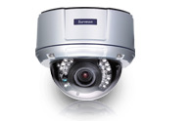
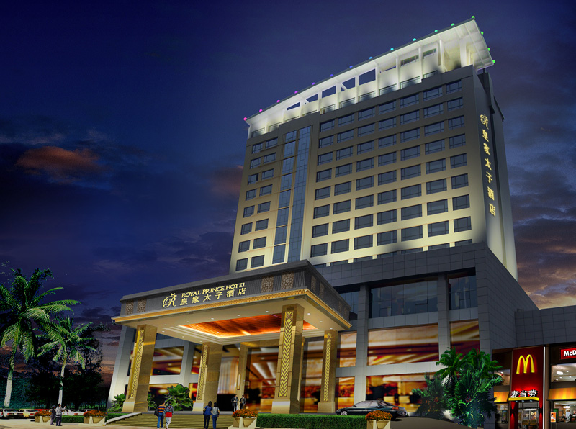
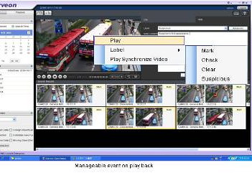
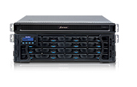
Surveon Hotel HD Surveillance Solution Intro.
Megapixel HD IP camera
Enterprise Level VMS Solution
Video Surveillance Storage

Slide 3
Hotel HD Surveillance Project Target
Hotel has a complex combination of crowd, high people traffic volume, 24-hour-open, cash flow number huge and more characteristics, this also reveals the management and security importance of hotel security system from the hotel staff, customers, visitor to the incoming and outgoing crowd.
Despite of incoming and outgoing crowd, room equipment and important equipment security , normal incidents like guest facilities accidents, the underworld trouble, service disputes, parking disputes, fire accidents, the hotel walls environment security
Many hotels invest much capital in surveillance system but the result can’t meet their expectation. Some issues like record data quality is not good enough, most of them are stored in CIF resolution which are hard to be recognized, system is not stackable or not easy to add more cameras to the installation , management operation is difficult and lousy, and record devices are unstable.
Owing that general security system Installer is lack of technical skills and rare has complete pure standalone end to end solution, installer often provide suggestion as old analog solution which can’t really meet client’s demand. The advantages HD digital security system indeed solving issues including, image resolution insufficient, scalability, and management. By providing several times of clear resolution comparing with current systems, the most concerning storage and hardware integration issue, via Surveon end to end, all-in-one own manufactured solution is solved, at the same time help integrator to Implement on related medical system surveillance programs.

Slide 4
Security Key Areas of Hotel
 | The main scene
Recreation area | Main entrance of the lobby, the lobby reception counter ,cash register, ballroom
Warehouse area | Stair waiting hall, elevator car box, room corridor
Access Control District | Valuables treasury, luggage storage room, machine rooms, loading dock
Logistics area | Entrance doors, building entrances, direct access to the outdoor side door, the door leading to the roof , fence of the hotel car park, monitoring center
Administrative area | Stairs walkways, place of doctor-patient communication, administrative divisions, security section
Notes:
4

Slide 5
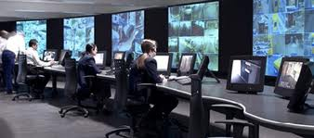
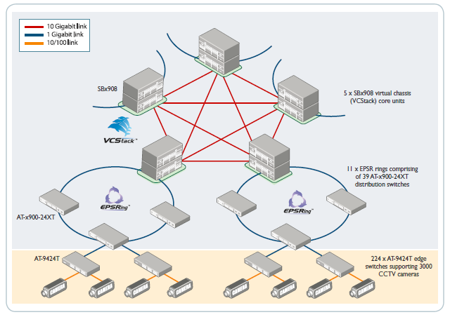

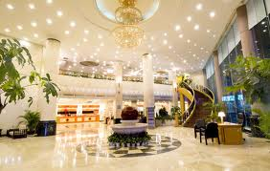
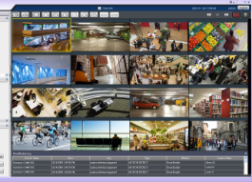
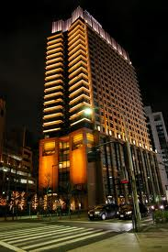
Standard system architecture - multi-level architecture
Hotel security monitoring center
Area security monitor
Recreation area
Hotel surroundings
Counter
Navigation
Registration
Prescriptions
Parking lot
Entrance
Guest parking Lane
…..
…
Local monitor A
Local monitor B
Support 2000+ views monitoring requirements, and can support multi-local and remote monitoring as well as on the TV wall equipment
Notes:
5

Slide 6
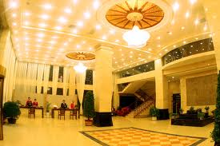
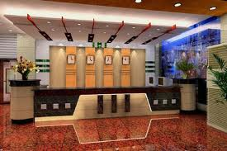
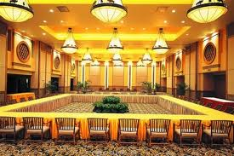
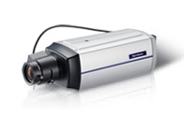
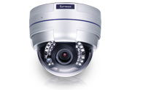
Recreation area cameras installation key areas
Lobby
Reception guests counters
Ball room
Lobby area monitor
Wide-angle HD camera
CAM2311P
Reception area monitor
Vari-focal HD camera
CAM4321
Ball room area monitor
Vari-focal HD camera
CAM4321
Notes:
6

Slide 7
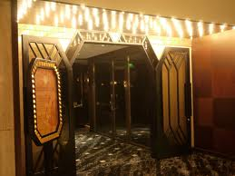
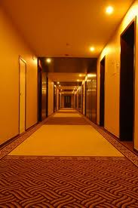
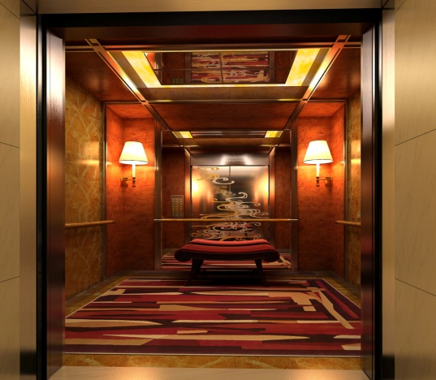
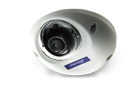
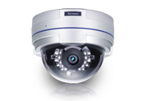
Entrance area HD camera installation key areas
Stairway waiting hall
Room corridor
Elevator Box
Waiting hall monitor VF HD Dome
CAM4321
Room corridor area monitor, HD vari-focal CAM4311
Elevator box security elevator mini color camera CAM1320
Notes:
7

Slide 8
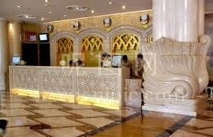
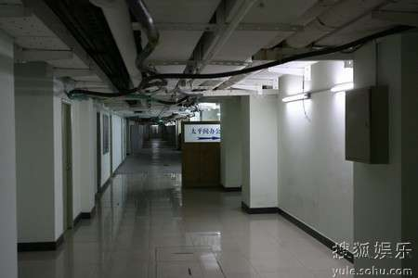
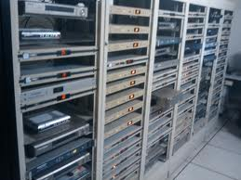
Warehouse room HD camera installation key areas
Valuables safe
Storage Room
Machine room
Treasury storage monitor, HD cameras
CAM2311P
Storage access control and protection
VF HD Dome
CAM4321
Access control and protection
Low light HD Box CAM2311P
Notes:
8

Slide 9
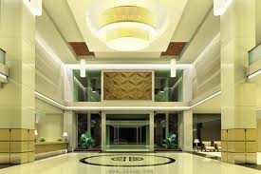
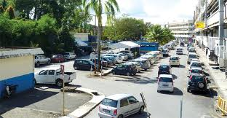
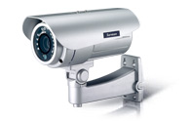
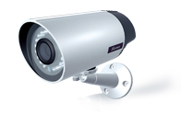
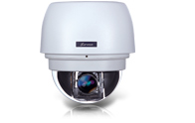
Logistical HD cameras installation key areas
Main Gate
Fence Area
Parking Lot
Around Gate and wide area
HD Dome CAM6351
Outdoor Parking lot and surroundings monitor
HD IP66 IR Bullet CAM3361
Outdoor fence area
HD IP66 IR Bullet
CAM3351
Notes:
9

Slide 10
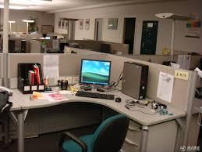
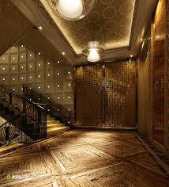
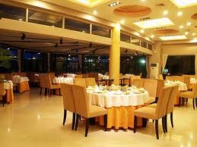
Administrative Region HD camera installation key areas
Stairways
Restaurant
Financial room
Stairway aisle entrance monitor
Vari-focal HD CAM4321
Restaurant monitor
Vari-focal HD CAM4321
Access control and operation monitor Low light HD Box CAM2311P
Notes:
10

Slide 11
Video Intelligence I- Business challenges
Improve Security control, special objects and People detection
Cash flow and customers flow security and control
Shorten Guest facilities accidents response time
Improve customers services and prevent service disputes
Fire accidents and smoke detection alarm
Notes:
11

Slide 12
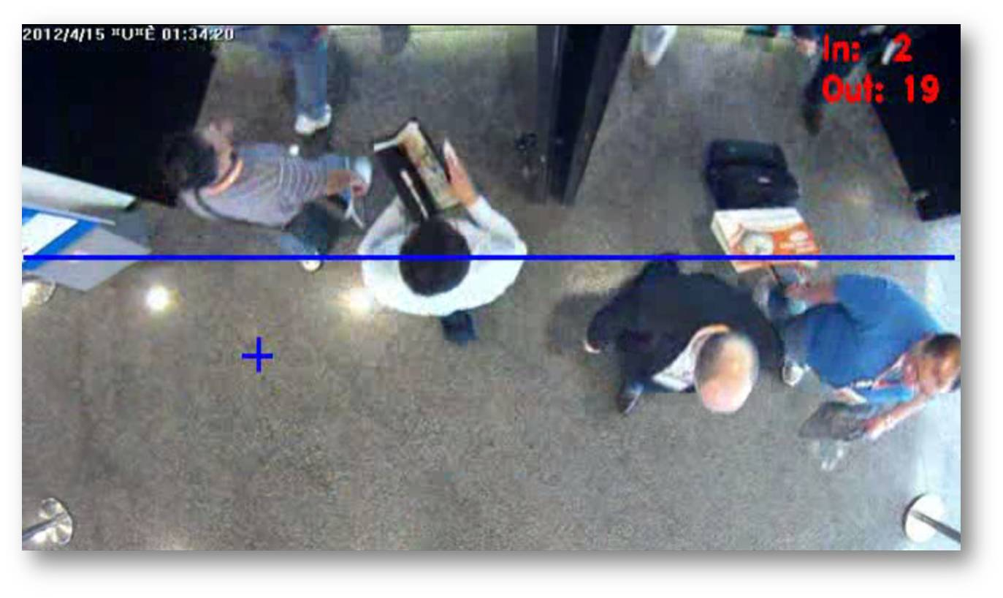
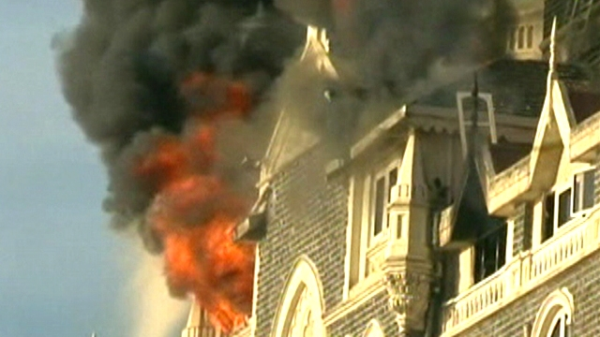
Video Intelligence II- Analytics Applications
Object counting:
One way or two way real time counting incoming and outgoing numbers of objects (people)
Fire and Smoke detection:
Integrated with I/O Box support, can help to notify fire department and security guard to take action in a short time
Notes:
12

Slide 13
Hotel HD video recording and management solution Configuration
 | Large hotel 100-500 Cameras | Medium Hotels 50 – 100 Cameras | Small Hotels Below 50 Cameras | Chains Hotel or Chains Motel
Record system | Centralized storage IP SAN | DAS RAID system | Embedded RAID controller | Embedded RAID controller
VI and Database system | NVR2100 | NVR2100 | SMR8000 | SMR5000
Client Management surveillance software | Surveon Client Enterprise software 2.4.8, Mobile client ,Browser client
CMS | Required, Manage multiple sites | Required, Manage multiple sites | Often not required, all in one | Required, Manage cross network sites
TV Wall Management | Required | Often not required | Not required | Required, manage cross network sites
Notes:
13

Slide 14
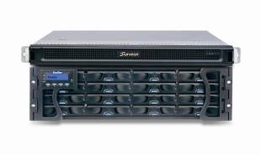

NVR2164 HD NVR
Industrial-level Xeon computing platform
Single NVR supports up to 64 cameras
full HD record
Each camera supports up to 1080P, 25 fps.
Support centralized storage IP SAN or DAS architecture
Scalable , supports up to 3000+ cameras in single domain
Complete End to End testing and certification
NVR2164 – 16B
Enterprise RIAD
Subsystem
Support maximum 480 TB
Enterprise-level RAID
Notes:
14

Slide 15
Medium-Large Hotel HD Record Project solution configuration – NVR2100 Series
Industrial-level Xeon computing platform
Single NVR supports up to 64 cameras
full HD record
Each camera supports up to 1080P, 25 fps
Suitable for 50 channels middle size to large scale
hotels usage
Support centralized storage IP SAN or DAS architecture
Scalable for storage capacity and cameras
NVR2164 – 16B
Enterprise RIAD
Subsystem
Support maximum 480 TB
Enterprise Level RAID
Notes:
15

Slide 16

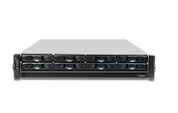
Small and medium-sized hospitals HD solution configuration - SMR8000 series
Support 16 – 40 Channels , Full HD Cameras video surveillance
Support up to 8 HHDD and Hardware
RAID protection
Rack mount and tower two solution
Virtual matrix , support up to 8 physical
monitors on single server
Support HTML integrated with View
Advance multi-layer E-Map
Client/Server Central management structure
Advance Event management record rule
SMR8040 Megapixel HD NVR
Notes:
16

Slide 17

Chains motel and hotel HD solution configuration – SMR5000 series
Support 12 – 20 Channels , Full HD Cameras video surveillance
Support up to 5 HHDD and Hardware
RAID protection
Virtual matrix , support up to 8 physical
monitors on single server
Support HTML integrated with View
Advance multi-layer E-Map
Client/Server Central management structure
Advance Event management record rule
SMR5020 Megapixel HD NVR
Notes:
17

Slide 18
18
Enterprise Level Video Management Platform features Overview
- To meet your professional security project

Slide 19
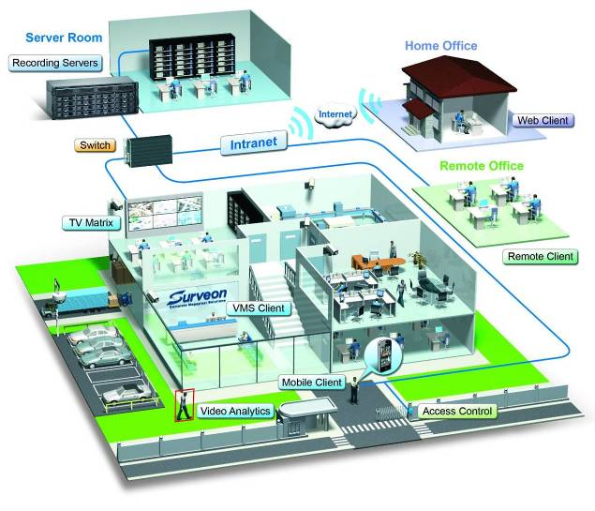
Distributed architecture of enterprise-level Video management platform
19
Module design
1. Record server
2. Domain Mgt. Server
3. VI Server
4. Client UI
5. Mobile Client
6. CMS client
Support 2000+ cameras monitor requirements, and can support multi-local and remote monitoring as well as TV Wall equipment

Slide 20
Versatile Live View mode
20
Virtual Matrix – More than 20 Views mode
Single client interface, including local and CMS client
Multi-level Active E-map
Supports HTML integration, Auto switch different Views , Stream Selection
Single client supports up to eight physical screen
Real-time playback, Video Bookmark
PTZ joystick , on screen PTZ control

Slide 21
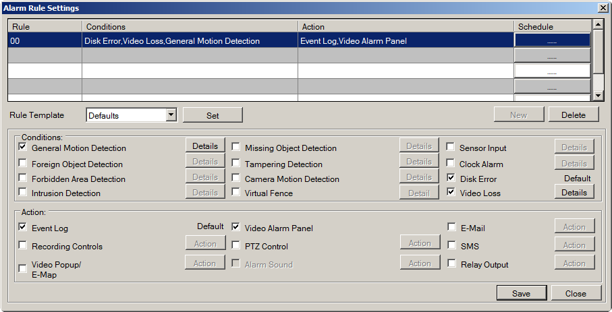
Advanced Alarm and Client Management
21
Multiple Alarm rules and schedule can be setup
Complete system management through client software
Multi-level user rights control
Client-Server, Domain management framework, all accounts, NVR centralized control
Advanced alarm configuration
Notes:
21
21

Slide 22

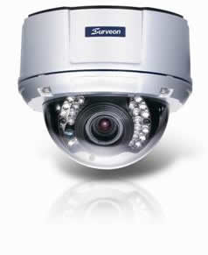
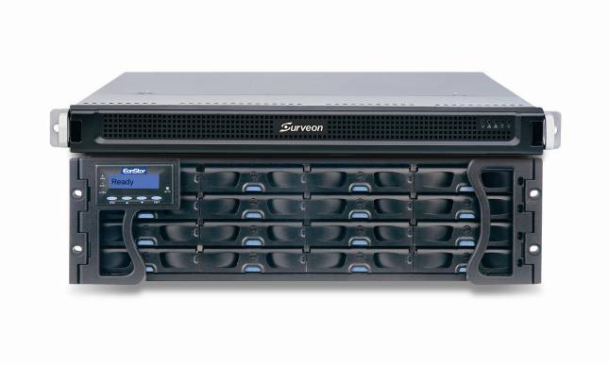
Recording Recovery for Offline
22
Record to camera SD card during network failure
Automatic resend the video to NVR
Automatic bandwidth control for resending video
Megapixel Camera
Megapixel RAID NVR
Video Management
Software
Prevent connection loss or cut off power connection by purpose

Slide 23
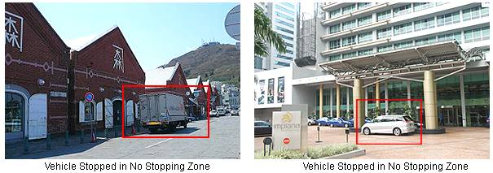
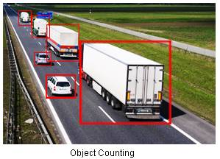
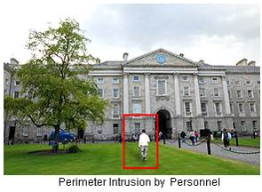
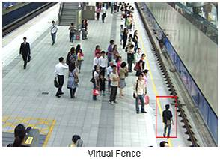
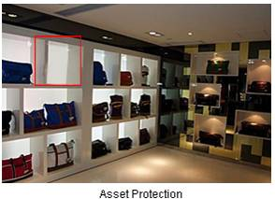
Real-time Video Analytics Engine
23

Slide 24
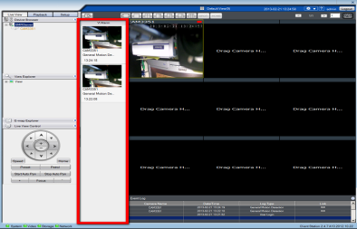
Investigation & Search
24
Real-time Video Alarm Panel Pop-up
Video Bookmark & Advanced Label-based Search
Sync and De-sync HD Video Playback
Multi Channel Video Backup
Mask and Watermark Control
Online and remote
Fast-forward and playback
Notes:
24
24

Slide 25
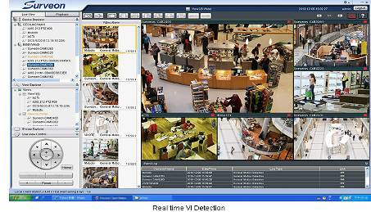
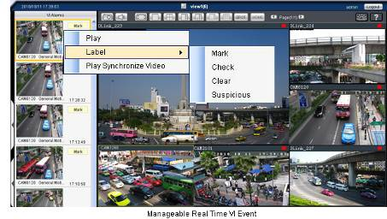
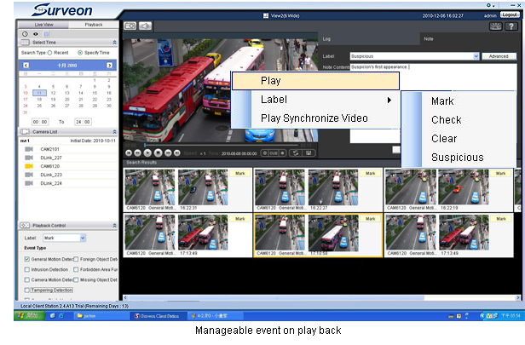
Actionable Monitoring & Smart Investigation
25
Instant View/PB VI Event
Video Clip Bookmark
Database Quick Event Query
Case Management
Notes:
Treplex design: live view, play back, and recording
Record by schedule, record by event
Playback smart investigation, search by event, search by VI
All the event will pop up from the window and the bodyguard can choose the action or come back to the logs later
VI engine
Design for scenarios

Slide 26
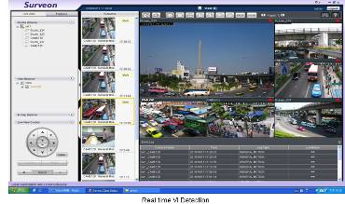
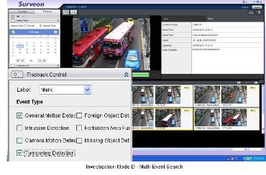
Local monitor mode and Active VI search
Support 1, 4, 5, 7, 9 – 32 View Auto Scan
Support local server Live View and playback
Support real time VI and alarm
Support advance alarm and trigger
Client/server central management infrastructure
Support remote control and playback
Advance Event management regulation
Notes:
26

Slide 27
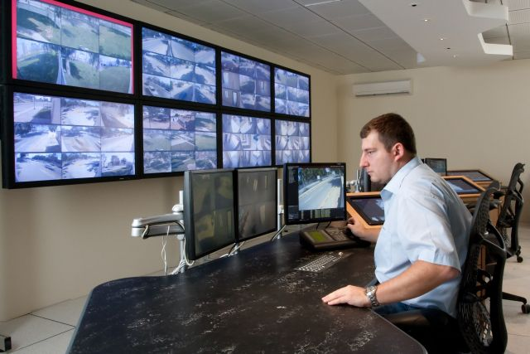
Remote client and TV wall matrix
Remote CMS Monitor can manage more than 3000 NVR servers
Centralization account and authority management
Different levels users for operation and available playback video control
Support TV Wall matrix
Control up to 120 monitors
simultaneously
Notes:
27

Slide 28
Surveon Solution Advantage
The only in house design camera, NVR and Storage devices provider in surveillance industry
End to End full integration. Performance and stability complete examination
Optimize and enhancement for high definition Management and recording
Design for NVR and Storage not simply outsourcing COTS solution bundle with software
High quality Megapixel HD Cameras and enterprise CMS software
15 years Taiwan company, worldwide customers and products
Full product line Industrial components and 3 year product warranty
Notes:
28

Slide 29
Question and Answer
Notes:
29

