Slide 1
Hospital HD Surveillance Solution
- Surveon Technology

Slide 2
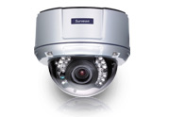
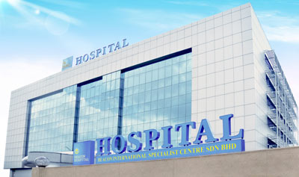
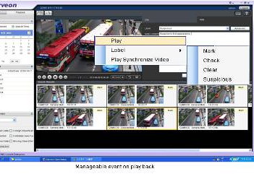
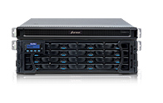
Hospital Surveillance Solution Intro.
Megapixel HD IP camera
Enterprise Level VMS Solution
Video Surveillance Storage

Slide 3
Hospital HD Surveillance Project Overview
Hospital has a complex combination of crowd, high people traffic volume, 24-hour-open, cash flow number huge and more characteristics, this also reveals the management and security importance of medical security system for the hospital from the medical staff, patients, family members to the incoming and outgoing crowd.
Despite of incoming and outgoing crowd, pharmacy and important equipment security , normal incidents like medical malpractice, hired hospital violator , and OPD even ward theft makes medical surveillance become a crucial element of hospital services and operations management.
Many hospitals invest much capital in surveillance system but the result can’t meet their expectation. Some issues like record data quality is not good enough, most of them are stored in CIF resolution which are hard to be recognized, system is not stackable or not easy to add more cameras to the installation , management operation is difficult and lousy, and record devices are unstable.
Owing that general security system Installer is lack of technical skills and rare has complete pure standalone end to end solution, installer often provide suggestion as old analog solution which can’t really meet client’s demand. The advantages HD digital security system indeed solving issues including, image resolution insufficient, scalability, and management. By providing several times of clear resolution comparing with current systems, the most concerning storage and hardware integration issue, via Surveon end to end, all-in-one own manufactured solution is solved, at the same time help integrator to Implement on related medical system surveillance programs.

Slide 4
Security Key Areas of the Medical institutes
 | The main scene
Medical district | Waiting hall, Registration, Ward aisle operating room, infusion room, emergency room, valuable equipment and data repository
Medical technology and warehouse area | Research building, central laboratory, pharmacy, Drug Storage Laboratory Medicine, Central Laboratory,
Access Control District | Finance, toll booths isotopes, pharmacies, warehouse, canteen warehouse
Logistics area | Hospital gate, the main building entrance, the hospital walls, hospital road, parking lot, security monitoring center
Administrative area | Stairs walkways, place of doctor-patient communication, administrative divisions, security section
Notes:
4

Slide 5
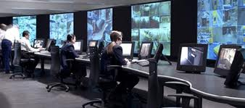
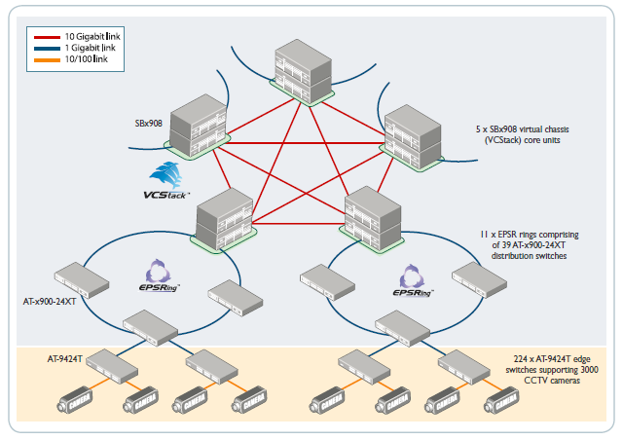

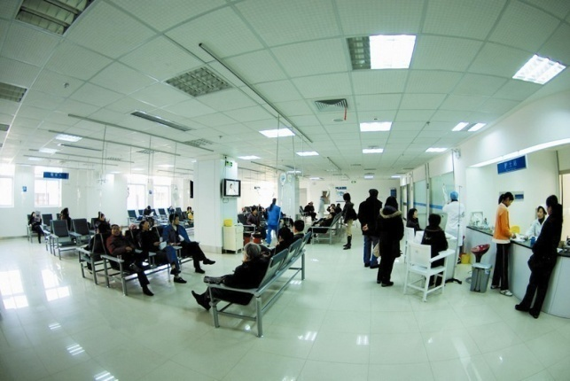
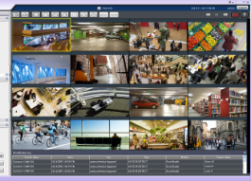
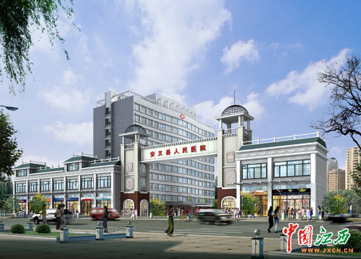
Standard system architecture - multi-level architecture
Hospital security monitoring center
Area security monitor
Lobby area
Hospital surroundings
Counter
Navigation
Registration
Prescriptions
Parking lot
Entrance
Ambulance Lane
…..
…
Local monitor A
Local monitor B
Support 2000+ views monitoring requirements, and can support multi-local and remote monitoring as well as on the TV wall equipment
Notes:
5

Slide 6
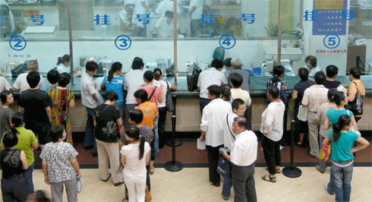
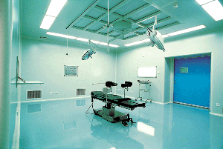
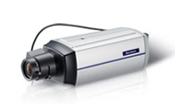
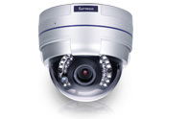
Medical HD cameras installation key areas
Waiting and emergency ball
Valuable equipment and data area
Registration and reception
Waiting area monitor
Wide-angle HD camera
CAM2311
Transaction zone monitor
Vari-focal HD camera
CAM4321
Valuable area monitor
Wide-angle HD camera
CAM2311
Notes:
6

Slide 7
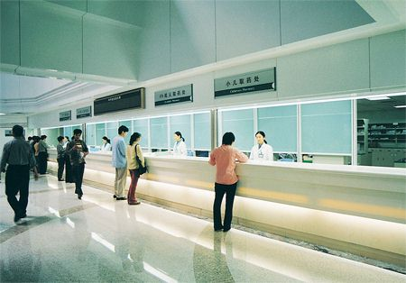
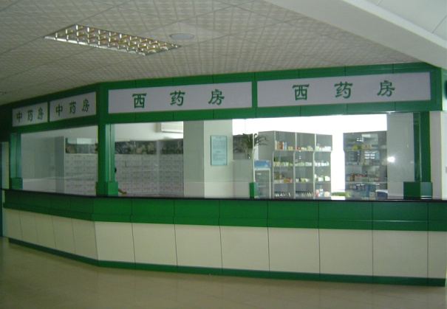
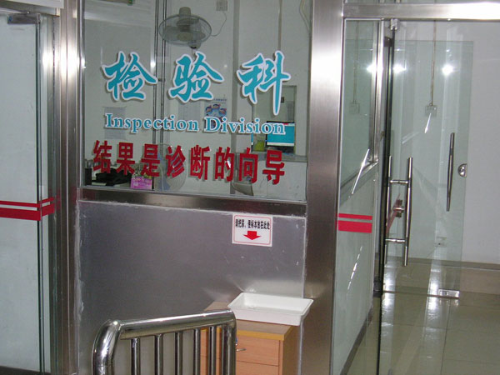
Medical Technology and warehouse HD camera installation key areas
Medicine Receiving
Drug Storage
Laboratory
Ensure medicine check
HD camera CAM2311
Pharmacy access control and protection
VF HD Dome
CAM4321
Access control and protection
Low light HD Box CAM2311
Notes:
7

Slide 8
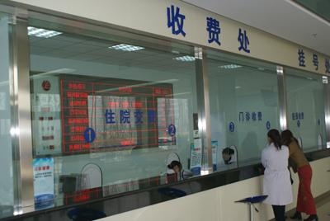
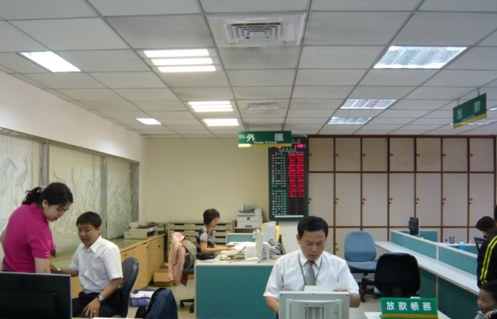
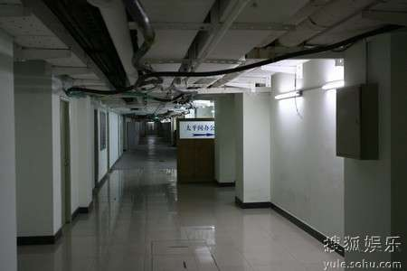
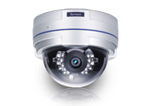
Access control HD camera installation key areas
Cashier
Financial & administrative
Important Storage
Transaction zone monitor
Vari-focal HD camera
CAM4321
Administrative area operation monitor
HD Vari-focal camera
CAM4311
Treasury unit monitoring
Vandal Proof HD Dome
CAM4361
Notes:
8

Slide 9
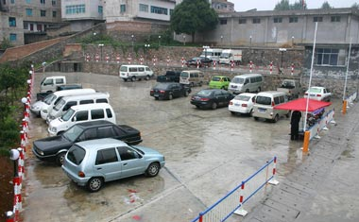
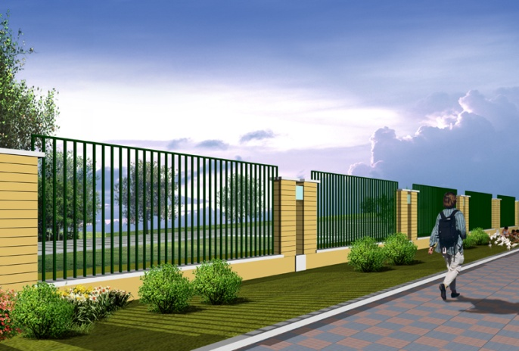
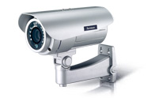
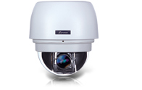
Logistical HD cameras installation key areas
Main Gate
Parking Lot
Fence Area
Around Gate and wide area
HD Box and Dome
CAM6351, CAM2311
Outdoor Parking lot and surroundings monitor
HD IP66 IR Bullet CAM3361
Outdoor fence area
HD IP66 IR Bullet
CAM3361
Notes:
9

Slide 10
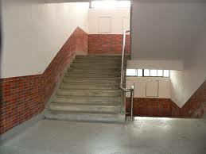
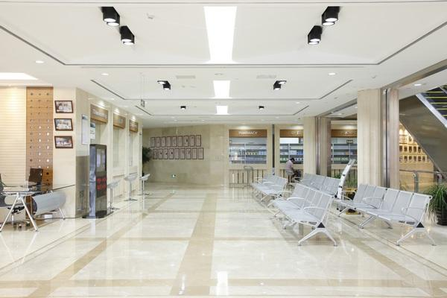
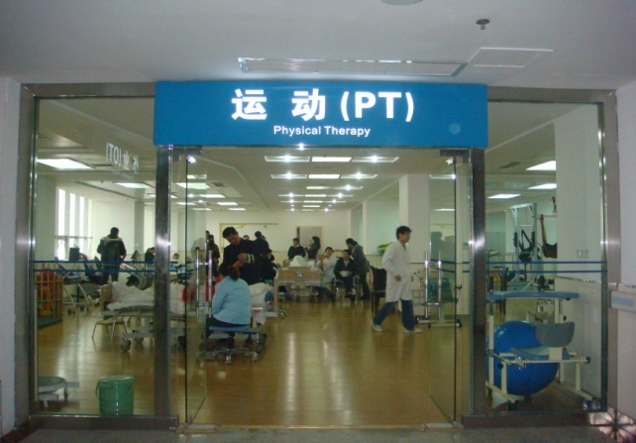
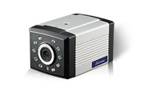
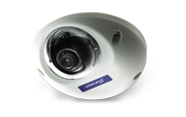
Administrative Region HD camera installation key areas
Stairways
Lounge
Administration
Stairway aisle entrance monitor HD IR Box CAM1301
Entrance monitor
HD IR mini Dome
CAM1320
Access control and operation monitor HD Mini Dome CAM1320
Notes:
10

Slide 11
Video Intelligence I – Business Chanelleges
Real-time Detection of Perimeter Intrusion & Secure Zone Breaches
Detect Unattended Objects
Identify Suspicious Activity
Real-time Detection of Blocked Emergency Passages / Exits
Safeguarding Assets
Notes:
11

Slide 12
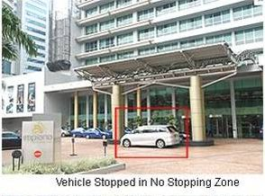
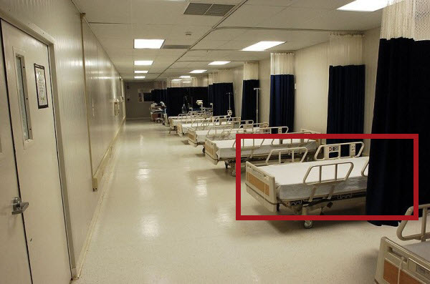
Video Intelligence II – Application
Forbidden area:
Vehicle that stops in preset forbidden area will trigger alarm to inform security guard to help remove the obstacle that blocks the main gate or entrance of ambulance lane
Missing Object detection:
Protect hospital assets if the asset is disappeared from the scene it will trigger alarm
Notes:
12

Slide 13
Hospital HD video recording and management solution Configuration
 | Large hospitals 100-500 Cameras | Medium Hospitals 50 – 100 Cameras | Small Hospitals Below 50 Cameras
Record system | Centralized storage IP SAN | DAS RAID system | Embedded RAID controller
VI and Database system | NVR2100 | NVR2100 | SMR8000
Client Management surveillance software | Surveon Client Enterprise software 2.4.8, Mobile client ,Browser client
CMS | Required, Manage multiple sites | Required, Manage multiple sites | Often not required, all in one
TV Wall Management | Required | Often not required | Not required
Notes:
13

Slide 14
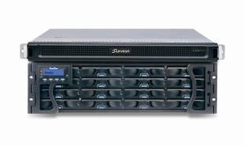

Medium-Large Hospital HD Record Project solution configuration – NVR2100 Series
Stand-alone supports up to 64 cameras full HD
Each camera 1080P more than 30 FPS
Suitable for more than 100 medium and large
hospitals projects
IP SAN or DAS architecture supports centralized
storage
Supports up to 3000 + cameras, up to
180-day recording
NVR2164 – 16B
Enterprise RIAD
Subsystem
Support maximum 480 TB
Enterprise Level RAID
Notes:
14

Slide 15

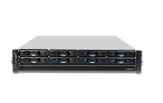
Small and medium-sized hospitals HD solution configuration - SMR8000 series
Support 16 – 40 Channels , Full HD Cameras video surveillance
Support up to 8 HHDD and Hardware
RAID protection
Rack mount and tower two solution
Virtual matrix , support up to 8 physical
monitors on single server
Support HTML integrated with View
Advance multi-layer E-Map
Client/Server Central management structure
Advance Event management record rule
SMR8040 Megapixel HD NVR
Notes:
15

Slide 16
16
Enterprise Level Video Management Platform features Overview
- To meet your professional security project

Slide 17
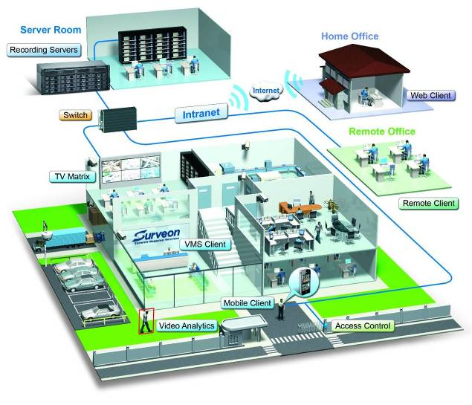
Distributed architecture of enterprise-level Video management platform
17
Module design
1. Record server
2. Domain Mgt. Server
3. VI Server
4. Client UI
5. Mobile Client
6. CMS client
Support 2000+ cameras monitor requirements, and can support multi-local and remote monitoring as well as TV Wall equipment

Slide 18
Versatile Live View mode
18
Virtual Matrix – More than 20 Views mode
Single client interface, including local and CMS client
Multi-level Active E-map
Supports HTML integration, Auto switch different Views , Stream Selection
Single client supports up to eight physical screen
Real-time playback, Video Bookmark
PTZ joystick , on screen PTZ control

Slide 19
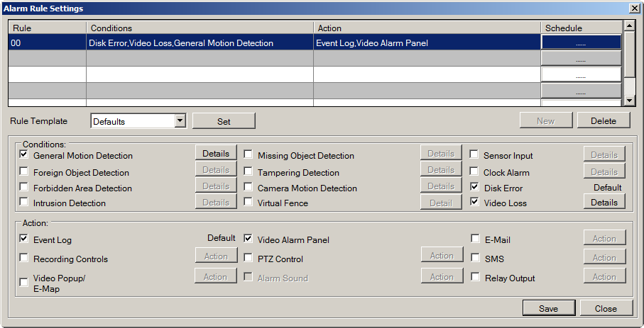
Advanced Alarm and Client Management
19
Multiple Alarm rules and schedule can be setup
Complete system management through client software
Multi-level user rights control
Client-Server, Domain management framework, all accounts, NVR centralized control
Advanced alarm configuration
Notes:
19
19

Slide 20

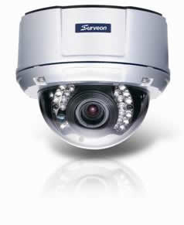
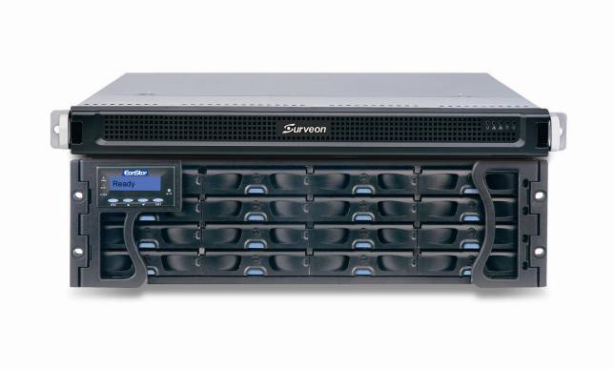
Recording Recovery for Offline
20
Record to camera SD card during network failure
Automatic resend the video to NVR
Automatic bandwidth control for resending video
Megapixel Camera
Megapixel RAID NVR
Video Management
Software
Prevent connection loss or cut off power connection by purpose

Slide 21
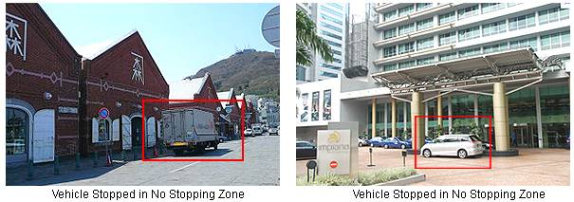

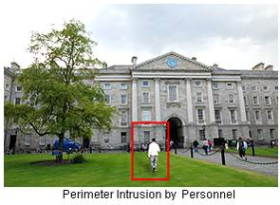
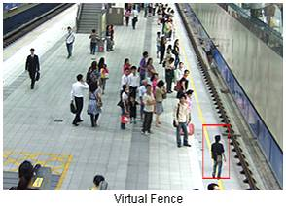
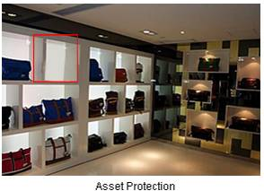
Real-time Video Analytics Engine
21

Slide 22
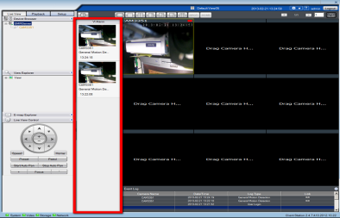
Investigation & Search
22
Real-time Video Alarm Panel Pop-up
Video Bookmark & Advanced Label-based Search
Sync and De-sync HD Video Playback
Multi Channel Video Backup
Mask and Watermark Control
Online and remote
Fast-forward and playback
Notes:
22
22

Slide 23
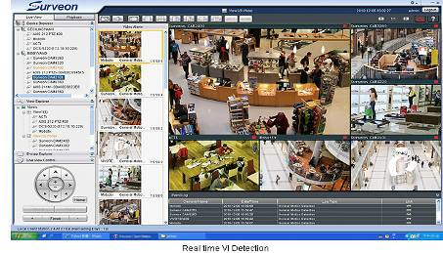
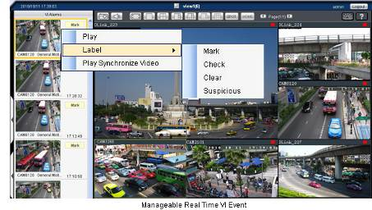
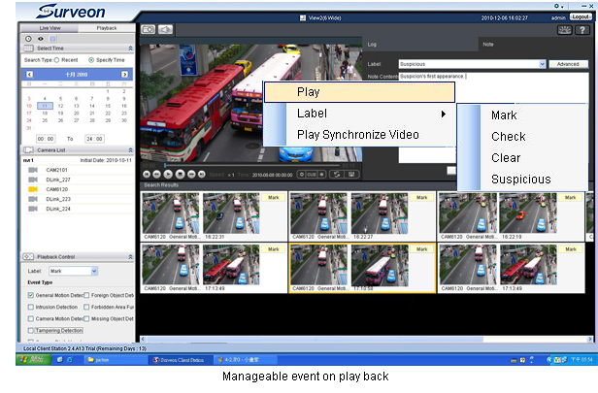
Actionable Monitoring & Smart Investigation
23
Instant View/PB VI Event
Video Clip Bookmark
Database Quick Event Query
Case Management
Notes:
Treplex design: live view, play back, and recording
Record by schedule, record by event
Playback smart investigation, search by event, search by VI
All the event will pop up from the window and the bodyguard can choose the action or come back to the logs later
VI engine
Design for scenarios

Slide 24
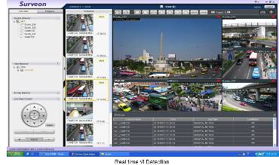
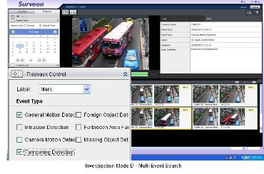
Local monitor mode and Active VI search
Support 1, 4, 5, 7, 9 – 32 View Auto Scan
Support local server Live View and playback
Support real time VI and alarm
Support advance alarm and trigger
Client/server central management infrastructure
Support remote control and playback
Advance Event management regulation
Notes:
24

Slide 25
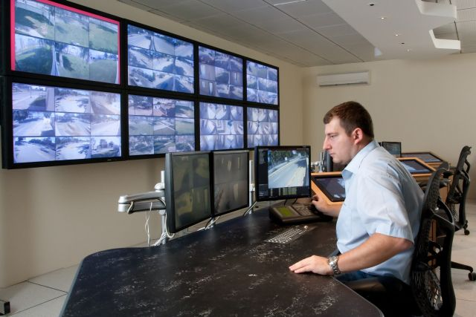
Remote client and TV wall matrix
Remote CMS Monitor can manage more than 3000 NVR servers
Centralization account and authority management
Different levels users for operation and available playback video control
Support TV Wall matrix
Control up to 120 monitors
simultaneously
Notes:
25

Slide 26
Surveon Solution Advantage
End to End full integration. Performance and stability complete examination
End to End 100% manufacture and production , Not outsourcing COTS solution
High quality Megapixel HD Cameras and enterprise CMS software
15 years Taiwan company, worldwide customers and products implementation
Full product line Industrial components and 3 year product warranty
Manufacture and made in Taiwan
Notes:
26

Slide 27
Question and Answer
Notes:
27

