Slide 1
Gas Station HD Video Surveillance Solution
- Surveon Technology
Sales & Marketing Department
Surveon Technology, 2013

Slide 2
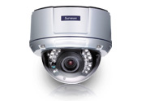
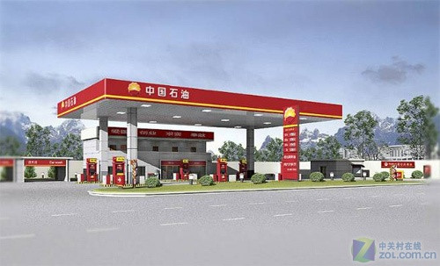
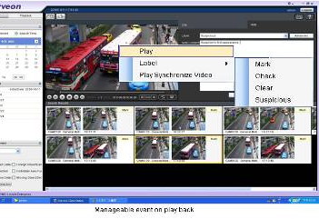
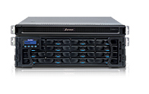
Surveon Gas Station HD Surveillance Solution Intro.
Megapixel HD IP camera
Enterprise Level VMS Solution
Video Surveillance Storage

Slide 3
Gas Station HD Surveillance Project Target
Gas station business revenue is growing up and Gas station is a risky and high transaction operation location. With integration of HD surveillance technology, higher resolution surveillance quality, and automatically integration of Intelligence, On CMS infrastructure basis to centralize controlling and managing single or multiple gas stations this becomes basic target of managing gas station chains or gas stations systems surveillance market project.

Slide 4
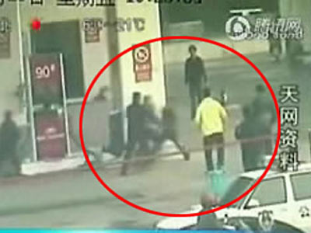
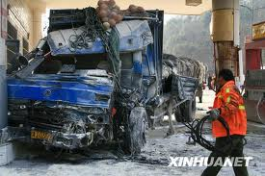
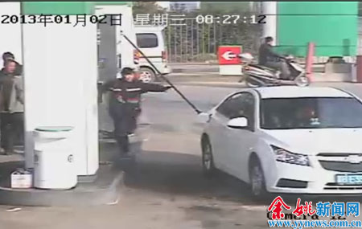
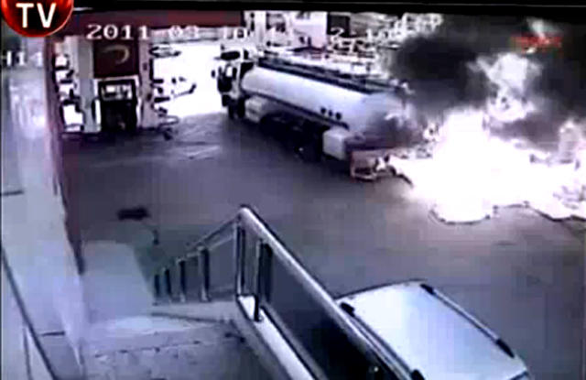
Circumstances Examples
Unknown man holding lighter robs gas station
Approach station accident management
Leaving without releasing oil pistol
Tank truck fire accident actively detection

Slide 5
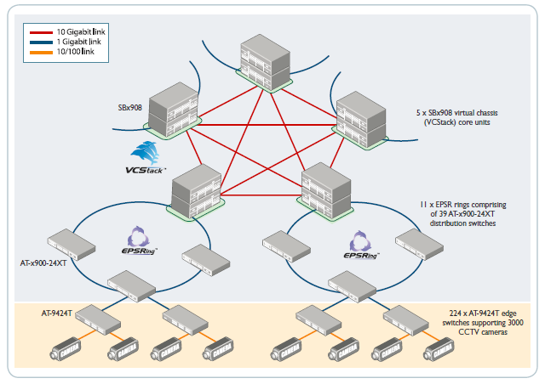
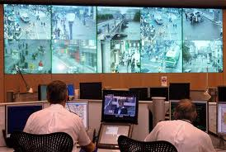
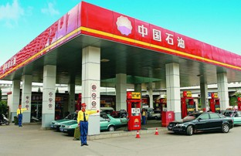
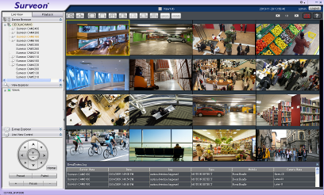
Standard System framework- Multi-Layer Framework
Remote centralizing monitor
Gas station Site
Gas station Site
Refuel
Tank
Operate
Dining
…
Refuel
Tank
Operate
Dining
Local monitor
Local monitor
Notes:
5
The information is from Seagate
Storage cost counts about 40% of the total budget in a project
And there is a high post sale maintenance fee for replacing and fixing the storage

Slide 6
Different Types of Gas station combination
 | Refuel area | Public/ Rest Area | Dining | Convenience Store | business abode
Premium/ Large station | 4 and above | Parking, Toilet, Public | Middle-Large Multiple stores | Middle-Large | Office, Treasury, Fuel Tank
City area /Middle size Station | 3 and above | Medium size toilet | Small size Single | Middle | Office, Treasury, Fuel Tank
Urban/ Small Size Station | 2 and above | Small size toilet | None | Small | Office, Treasury, Fuel Tank
Notes:
6
The information is from Seagate
Storage cost counts about 40% of the total budget in a project
And there is a high post sale maintenance fee for replacing and fixing the storage

Slide 7
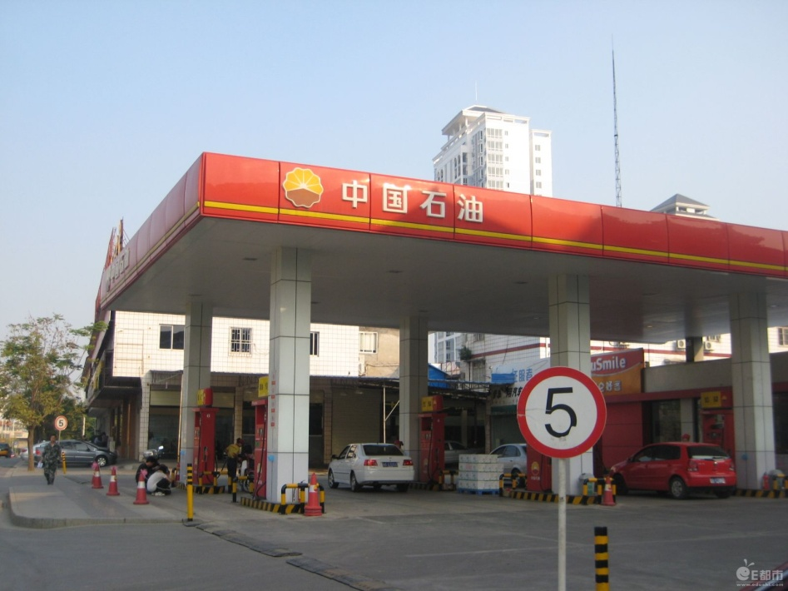
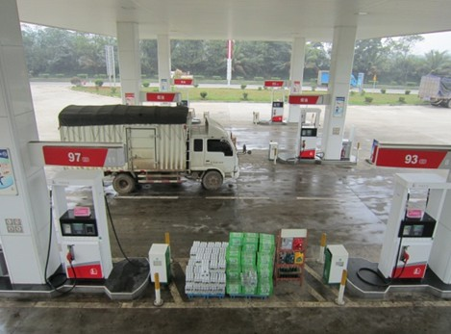
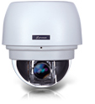
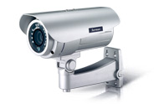
Surveon Gas Station HD Surveillance Camera installation Standard-Refuel Area
Enter/Exit and related area-optional - Adopt large area HD speed dome,
CAM6351 2M HD Speed Dome
Refuel Area and charge area surveillance – standard – Vari-focal Lens, low lux, IP66, ICR CAM3361 2M IR bullet type. Every lane 1-2 cameras (bi-directional)
Ensure Enter/Leave refuel area control , human and car accident or abnormal charge operation
Notes:
7
The information is from Seagate
Storage cost counts about 40% of the total budget in a project
And there is a high post sale maintenance fee for replacing and fixing the storage

Slide 8
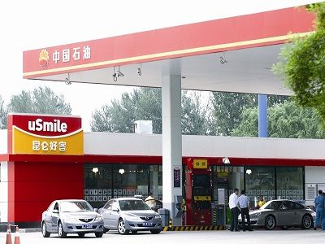
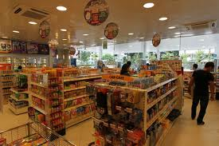
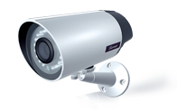
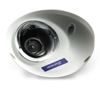
Gas Station HD Surveillance Camera installation-Convenience store
Inside monitor– standard
fixed-focal lens, low lux, IR
CAM3351 2MP fixed-focal lens
IR bullet camera
CAM1320 2MP indoor dome
Camera for shopping lane and
Cash register
Enter/Exit and related area-optional - Wide angle, fixed focus lens,IP66, ICR, CAM3351, 2M fixed focus lens bullet camera
General cash register monitor and area surveillance
Notes:
8
The information is from Seagate
Storage cost counts about 40% of the total budget in a project
And there is a high post sale maintenance fee for replacing and fixing the storage

Slide 9
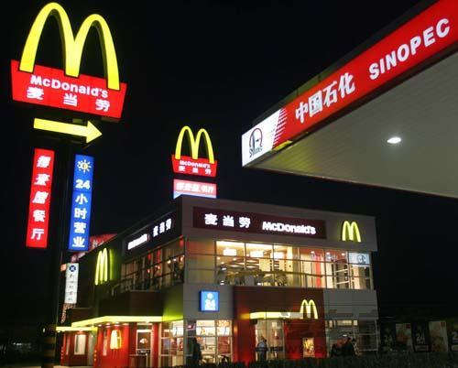
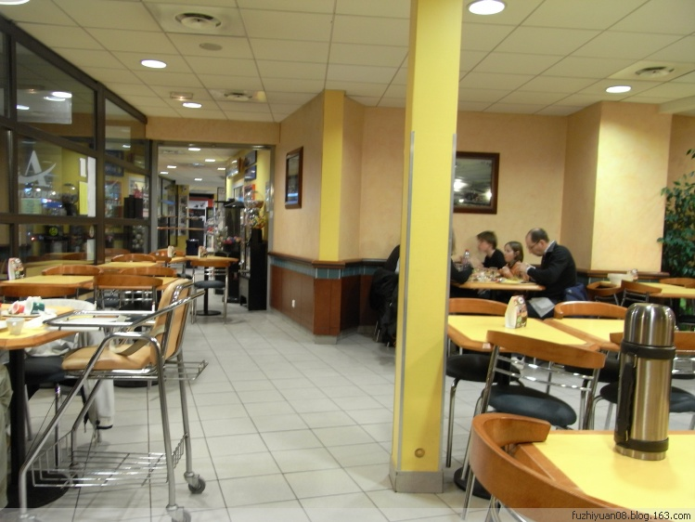
Gas station Restaurant surveillance equipment suggestion
entrance and exit area monitor– standard-Wide angle, fixed focal lens, IP66, IR CAM3351 2MP fixed focal IR bullet camera
Inside monitor – standard
CAM1320 2MP indoor dome camera-Dining , stock entrance, cash register area
Restaurant entrance and exit, parking and cash register area surveillance
Notes:
9
The information is from Seagate
Storage cost counts about 40% of the total budget in a project
And there is a high post sale maintenance fee for replacing and fixing the storage

Slide 10
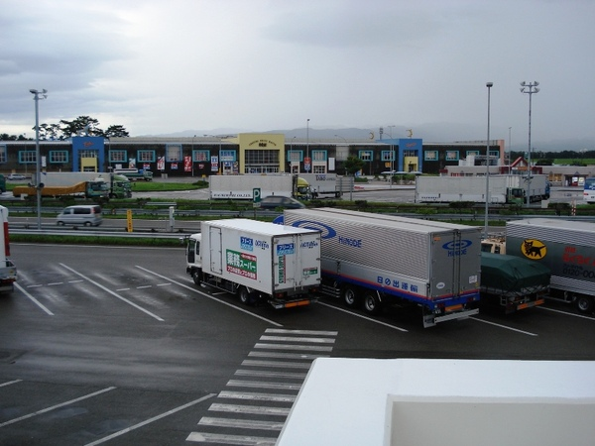
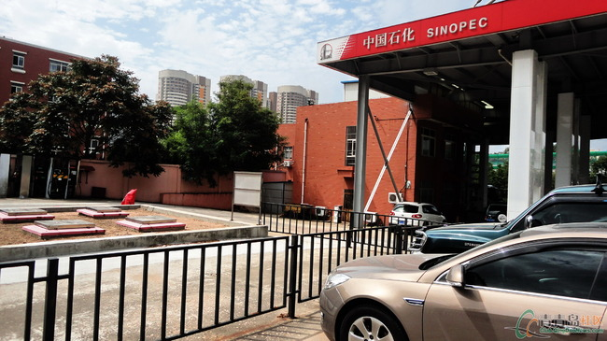
Gas station Public area
Parking lot, fuel tank ,large area – standard – wide angle, vari-focal lens,IP66,IR CAM3361 2MP vari-focal IR bullet camera
Fuel tank, outdoor area, small size parking lot
CAM3361
Large or small size parking lot entrance , rest area entrance, fuel tank, public toilet
Notes:
10
The information is from Seagate
Storage cost counts about 40% of the total budget in a project
And there is a high post sale maintenance fee for replacing and fixing the storage

Slide 11
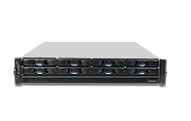
NVR and surveillance solution - SMR8000 Series
Support 16 – 40 Channels , Full HD Cameras video surveillance
Support up to 8 HHDD and Hardware
RAID protection
Rack mount and tower two solution
Virtual matrix , support up to 8 physical
monitors on single server
Support HTML integrated with View
Advance multi-layer E-Map
Client/Server Central management structure
SMR8040 Megapixel HD NVR
Notes:
11
The information is from Seagate
Storage cost counts about 40% of the total budget in a project
And there is a high post sale maintenance fee for replacing and fixing the storage

Slide 12
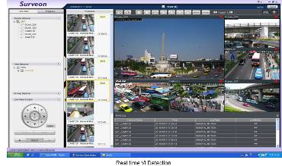
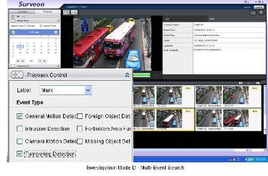
Local monitor mode and Active VI search
Support 1, 4, 5, 7, 9 – 32 View Auto Scan
Support local server Live View and playback
Support real time VI and alarm
Support advance alarm and trigger
Client/server central management infrastructure
Support remote control and playback
Advance Event management regulation
Notes:
12
The information is from Seagate
Storage cost counts about 40% of the total budget in a project
And there is a high post sale maintenance fee for replacing and fixing the storage

Slide 13
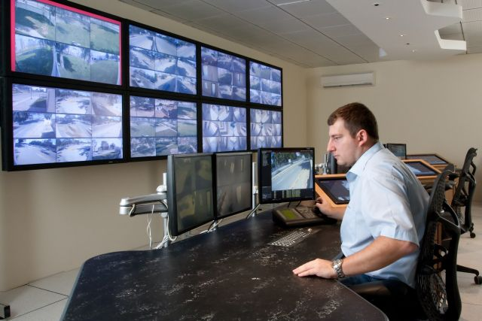
Remote client and TV wall matrix
Remote CMS Monitor can manage more than 3000 NVR servers
Centralization account and authority management
Different levels users for operation and available playback video control
Support TV Wall matrix
Control up to 120 monitors
simultaneously
Notes:
13
The information is from Seagate
Storage cost counts about 40% of the total budget in a project
And there is a high post sale maintenance fee for replacing and fixing the storage

Slide 14
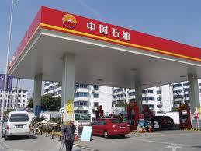
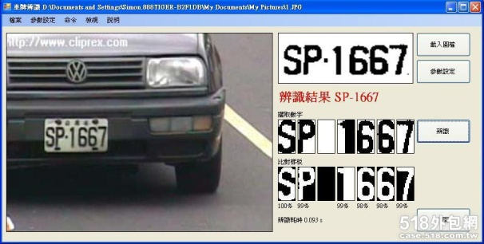

Advance Alarm trigger control and LPR integration
Setup auto or manual alarm trigger and have connection with camera in focus area, also can setup alarm rule to start recording or alarm action in system
Install LPR camera in car lane(integrated by request) to make use on advance camera search
Notes:
14
The information is from Seagate
Storage cost counts about 40% of the total budget in a project
And there is a high post sale maintenance fee for replacing and fixing the storage

Slide 15
Solution List
 | Refuel Area | Public and rest area | Dining | Convenience store | Business abode
Camera | CAM3361 | CAM3361 CAM3351 | CAM1320 | CAM1320 | CAM1320 CAM3351
NVR | SMR 8000 HD RAID NVR Series
Central management software | Surveon Enterprise level VMS ES 2.4.8 Surveon central management solution CMS 2.4.8 Surveon CMS TV Matrix CMS 2.4.8
Notes:
15
The information is from Seagate
Storage cost counts about 40% of the total budget in a project
And there is a high post sale maintenance fee for replacing and fixing the storage

Slide 16
Challenges on Video Intelligence of Gas station
Manage Inventory Loss – reduce shrinkage and improve overall operational efficiency
Comprehensive video analytics – prevents real-time security breaches
Monitors and assesses employee performance and adherence to policy and procedures
Measures customer traffic flow and patterns

Slide 17
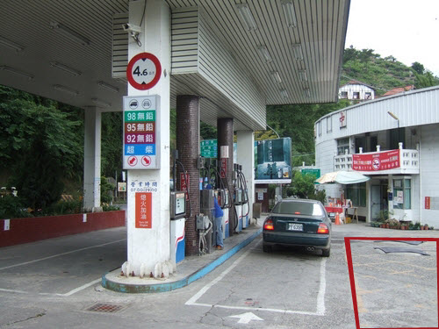
Gas station Video Intelligence Application I
License Plate recognition(TBD):
Every car that enter and leave gas station, License number will be recognized and stored into database for usage.
Forbidden Area:
Once any preset size of vehicle stops in this area and stay longer than preset time, it will trigger alarm for alert

Slide 18
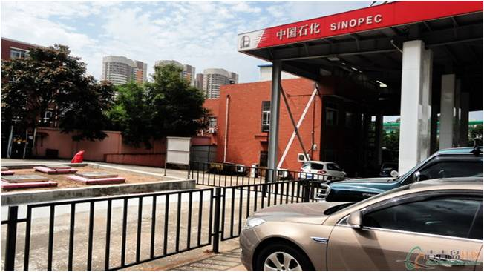

Gas station Video Intelligence Application II
Foreign Object：
For those objects that shall not appear in an preset area, it will send out alarm and notify security staffs
Tampering Detection：
When the camera scene has been changed or the direction of the camera has been modified it will trigger alarm and notify security staffs

Slide 19
Surveon Solution Advantage
End to End full integration. Performance and stability complete examination
End to End 100% manufacture and production , Not outsourcing COTS solution
High quality Megapixel HD Cameras and enterprise CMS software
15 years Taiwan company, worldwide customers and products implementation
Full product line Industrial components and 3 year product warranty
Manufacture and made in Taiwan
Notes:
19
The information is from Seagate
Storage cost counts about 40% of the total budget in a project
And there is a high post sale maintenance fee for replacing and fixing the storage

Slide 20
Question and Answer
Notes:
20
The information is from Seagate
Storage cost counts about 40% of the total budget in a project
And there is a high post sale maintenance fee for replacing and fixing the storage

