Slide 1
Enterprise Factory Solution
-Surveon Technology
Sales & Marketing Department
Surveon Technology, 2013

Slide 2
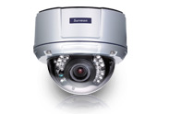
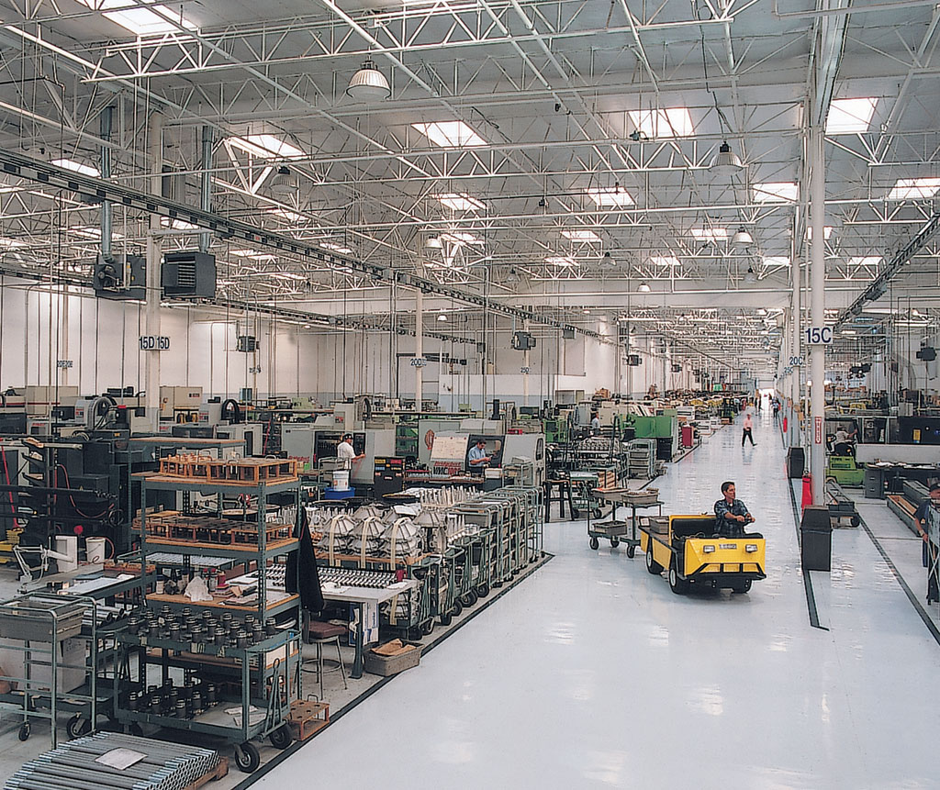
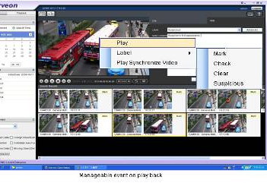
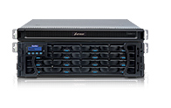
Enterprise Factory HD surveillance solution
Megapixel HD IP camera
Enterprise Level VMS Solution
Video Surveillance RAID Storage

Slide 3
Enterprise Factory HD Surveillance key objectives
Enterprises factory is no longer the traditional concept of the manufacturing, materials processing and other simple superposition, but includes administrative, research and development, production, reception, restaurants, Logistics Department, parking, multi-functional regions. From an engineering point of view, enterprise factory has lager scale , more subsystems and requires integrated compatibility platform to manage all subsystems. Enterprise factory monitors a wide range of protected objects, and its security system is more complex than a typical project which usually requires integrated video surveillance systems, access control systems, alarm systems, perimeter protection system, general requirements for enterprise security factories control by department and centralized management, and it has relatively high scalability requirements 。
Surveon with all in-house design from the camera to the storage production capacity of more than 15 years in the storage and security projects accumulated strength, provides our partners a truly complete and highly reliable solution. Surveon enterprise-level client-server architecture management software can help integrators resolve the openness and scalability needs.

Slide 4
Security Key Areas of Enterprise factory
 | Main scene
Manufacture area | Production plants, valuable equipment placement office, laboratory
Access control area | Reception, shipping and receiving department, warehouse
Logistics area | Factory gates, the main building entrance, restaurant, factory fences, plant roads, parking lots, control centers, etc.
Administrative area | Stairs walkways, conference rooms, administrative divisions

Slide 5
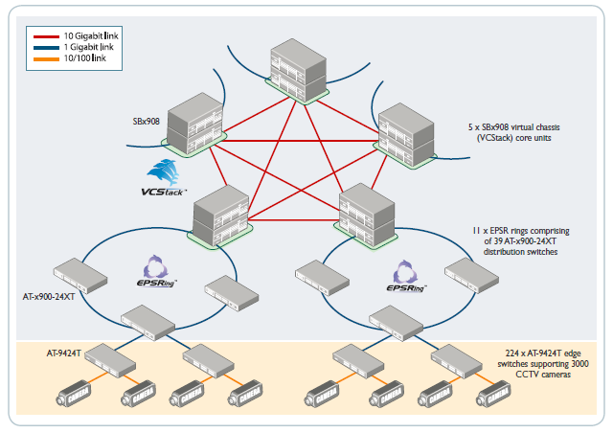

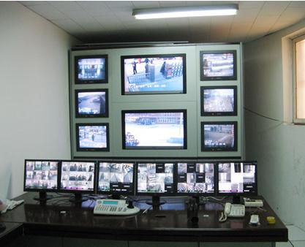
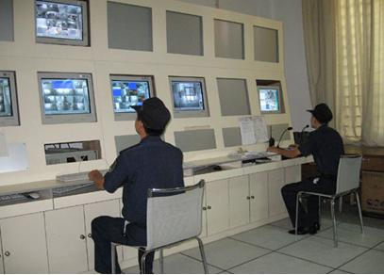
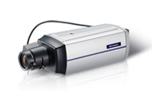
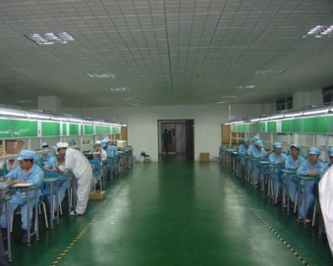
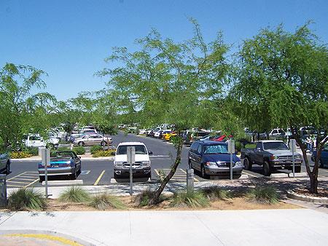
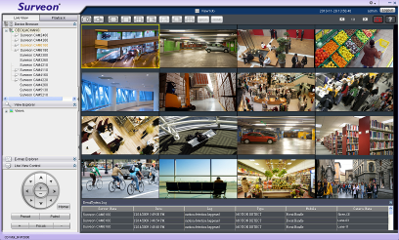
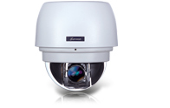
Enterprise Level Client-Server Architecture Video Surveillance Solution
IP SAN
Plant monitoring center
Division monitor
Area monitor
Area monitor
Production
Shipping
Reception
…
Logistic
Admin
Parking
Local monitor A
Local monitor B
Notes:
5

Slide 6

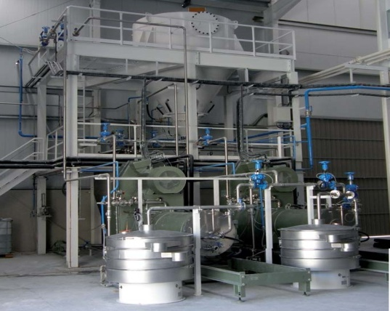

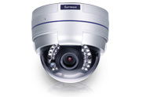
Production Area HD cameras installation key areas
Production Area
Valuable equipments area
Laboratory area
Ensure materials check
HD camera CAM2311
Access control and protection
VF HD Dome CAM4321
Access control and protection
Low light HD Box CAM2311
Notes:
6

Slide 7
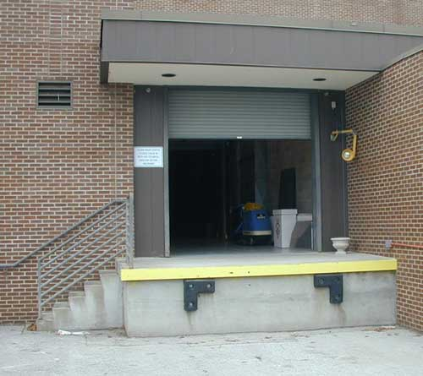
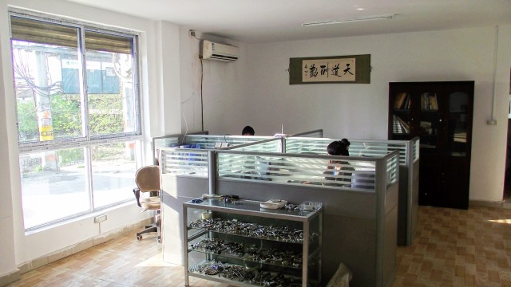
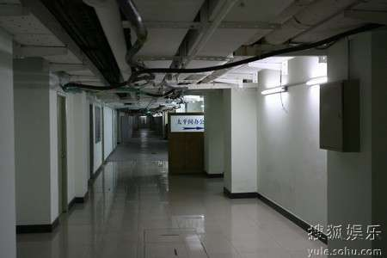
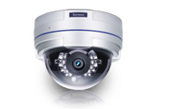
Access control HD cameras installation key areas
Shipping and receiving
Reception
Warehouse
Shipping zone monitor Vari-focal HD camera CAM4321
Operation and access control monitor
HD Vari-focal camera
CAM4311
Treasury unit monitoring
Vandal Proof HD Dome
CAM4361
Notes:
7

Slide 8
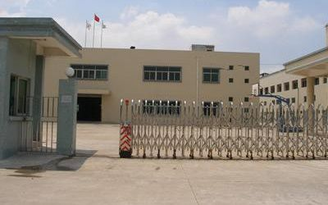
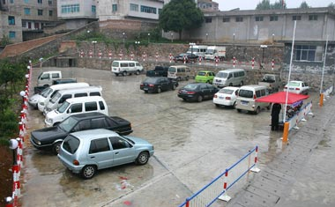
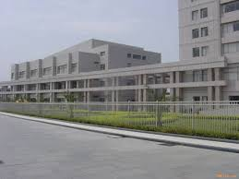
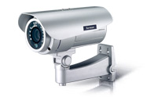
Logistical HD cameras installation key areas
Main Gate
Parking lot
Fence Area
Around Gate and wide area HD Box and Dome
CAM6351, CAM2311
Outdoor Parking and surroundings monitor
HD IP66 IR Bullet CAM3361
Outdoor fence area
HD IP66 IR Bullet
CAM3361
Notes:
8

Slide 9
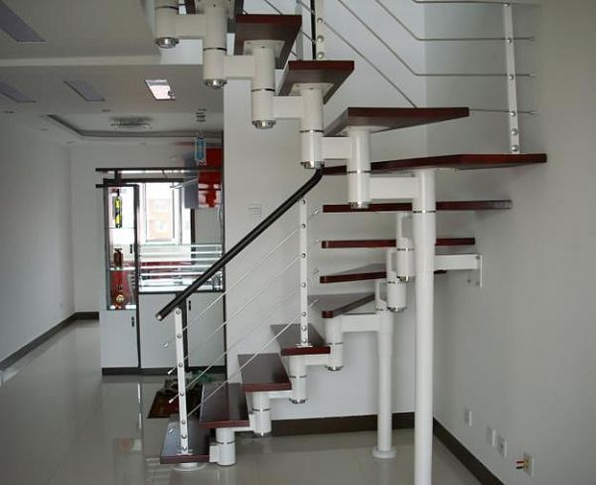
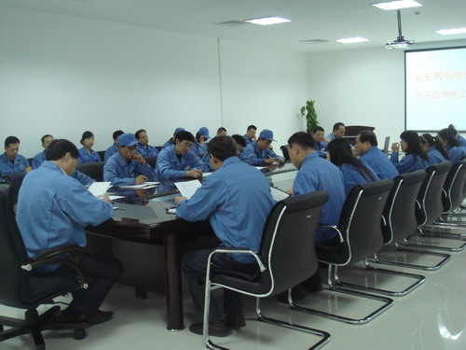
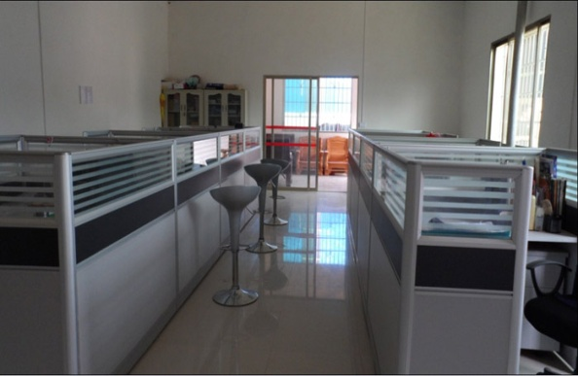
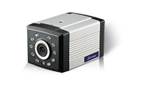
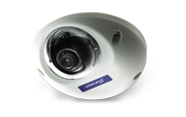
Administrative Region HD camera installation key areas
Stairways
Conference room
Administration
Stairway aisle entrance monitor HD IR Box CAM1301
Entrance monitor
HD IR mini Dome
CAM1320
Access control and operation monitor HD Mini Dome CAM1320
Notes:
9

Slide 10
Video Intelligence I – Business Chanelleges
Real-time Detection of Perimeter Intrusion & Secure Zone Breaches
Detect Unattended Objects
Identify Suspicious Activity
Real-time Detection of Blocked Emergency Passages / Exits
Safeguarding Assets
Movement in Restricted Areas
Notes:
10

Slide 11
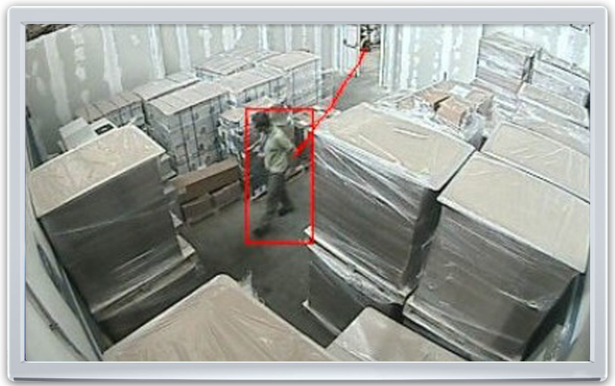
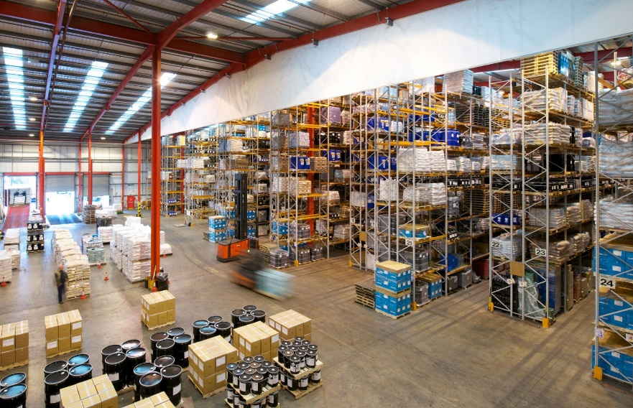
Video Intelligence II – Application
Forbidden area:
People that enter preset forbidden area will trigger alarm to inform security guard to help identify intension and authority of access to the area
Foreign object:
Warehouse and stock inventory real time inspection, if there is any object item that shall not exit inside pre-set zone, it will notified the security guard
Notes:
11

Slide 12
Enterprise factory Surveillance Solution
 | Small enterprise factory 16-32 CH | Medium enterprise factory 32 – 100 CH | Large scale enterprise factory 100+ CH
VI and Database system | SMR8000 Series | NVR2100 DAS Series | NVR2100 – IP SAN Series
 | Internal up to 8 HDD | DAS up to120 HDD | IP SAN, No limitation
Client Management surveillance software | Surveon Client Enterprise software 2.4.8, Mobile client ,Browser client
CMS | Required, Manage multiple sites | Required, Manage multiple sites | Required, Manage multiple sites
SDK | Surveon NVR SDK | Surveon NVR SDK | Surveon NVR SDK
TV Wall | Yes | Yes | Yes
Notes:
12

Slide 13
Enterprise Factory Standard 32 CH Package
Medium-Small enterprise factory standard package implementation
 | Cameras | Record days | Daily record hour | Frame rate and bit rate
Project included | 32 Full HD cameras | 30 days | 24 hours | 25 FPS @ 6Mbps
Note | This program has been validated over hundreds of hours of complete end-to-end verification from the camera, NVR storage and practical application to the global security projects
Notes:
13

Slide 14
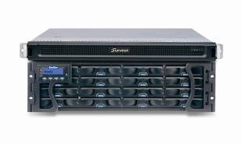
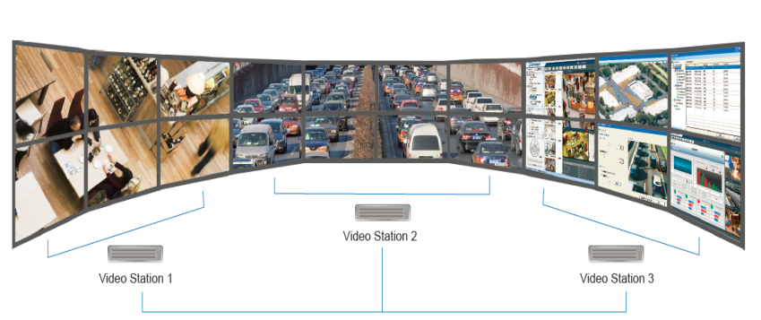
100+ CH Package, High scalability
32CH Package
100CH Package
100 +CH Package
…
Including cameras, NVR, RAID.30 days 24 hours video
Including cameras, NVR, RAID.30 days 24 hours video
Including cameras, NVR, RAID.30 days 24 hours video
Supports online extension to be added and controlled under same domain server & CMS
TV wall and matrix client can extend unlimited
Notes:
14

Slide 15
Storage requirements configuration
28 HD cameras & 30 days video
RAID 6 or RAID5 + 1
HDD Size | Enclosure | Number of Disk | Number of Enclosure
1TB | 12 Bay | 345 | 29
1TB | 16 Bay | 329 | 21
2TB | 12 Bay | 174 | 15
2TB | 16 Bay | 166 | 11
3TB | 12 Bay | 116 | 10
3TB | 16 Bay | 110 | 7
4TB | 12 Bay | 88 | 8
4TB | 16 Bay | 84 | 6
RAID 5
HDD Size | Enclosure | Number of Disk | Number of Enclosure
1TB | 12 Bay | 314 | 27
1TB | 16 Bay | 307 | 20
2TB | 12 Bay | 158 | 14
2TB | 16 Bay | 154 | 10
3TB | 12 Bay | 105 | 9
3TB | 16 Bay | 103 | 7
4TB | 12 Bay | 79 | 7
4TB | 16 Bay | 77 | 5
Included hard disk consumption and RAID configuration demand
Notes:
15

Slide 16
NVR2132 HD NVR
Industrial-level Xeon computing platform
Single NVR supports up to 64 cameras
full HD record
Each camera supports up to 1080P, 25 fps.
Support centralized storage IP SAN or DAS architecture
Scalable , supports up to 3000+ cameras in single domain
Complete End to End testing and certification
NVR2164 – 16B
Enterprise RIAD
Subsystem
Support maximum 480 TB
Enterprise-level RAID
Notes:
16

Slide 17
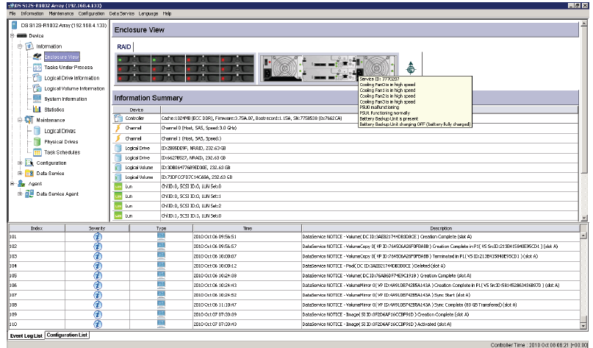
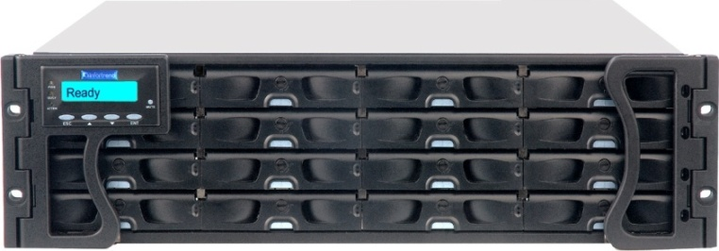
EonStor High Performance iSCSI Storage
Over 200,000 installation worldwide
High-performance controller: RISC Power PC - not X 86 architecture
High stability: own ASIC chip - dedicated RTOS, not Linux standard program
Remote management and control, advanced storage features: off-site backup, virtualization
Support up to 112 HDD(2, 3, 4TB)
Fully modular wired-less design - best seismic, thermal design
SANWatch Control Software
ESDS Series
Notes:
17

Slide 18
CAM2311 HD Camera Series
Support H.264 compression with 1920 x 1080 @ 25 fps
Built-in SD Card support network supports failover and recovery
Independent ISP supports 3D noise reduction, WDR, multi-zone HLC, De-fog
Support standard RS-485,audio and DI/O control
Full Aluminum body, High stability and
performance thermal design
Advance Super Low Light enhancement mode
Supports full series 2M,3M and 5M solution
CAM2311 Series
Full HD Network Camera
Notes:
18

Slide 19
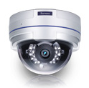
CAM4311 D/N IP Fixed Dome
Full HD & Real Time Network Camera
Up to 1920 x 1080 Video Resolution
H.264/MPEG4/MJPEG 2 Simultaneous Video Streams
Surveon Video Intelligent Ready
MicroSD/SDHC Local Storage for Alarm Capture
Power over Ethernet (IEEE 802.3af)
Day/Night Function with IR-Cut Filter
Built-in IR Illuminators, Effective Up to 10 Meters
CAM4311 Series
2M D/N IP Fixed Dome
Notes:
19

Slide 20
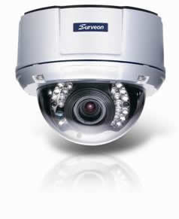

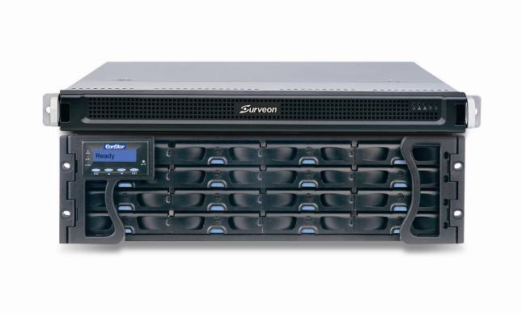
Recording Recovery for Offline
20
Record to camera SD card during network failure
Automatic bandwidth control for resending video, preventing influencing live video streaming
Front End Megapixel Camera
NVR2164 - RAID NVR
Video Management
Software
Suitable for large-scale cross-network city surveillance project

Slide 21
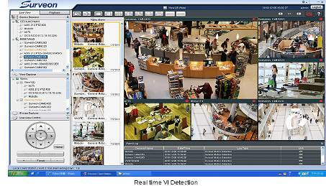
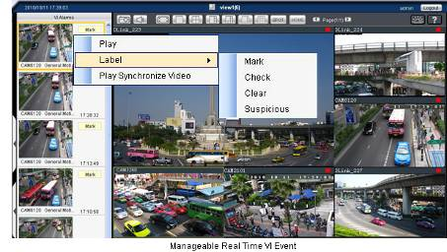
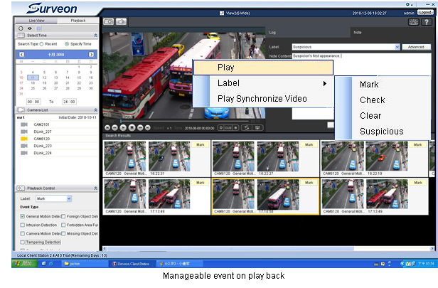
Actionable Monitoring & Smart Investigation
21
事件影像自动弹出
Instant View/PB VI Event
事件影像标记
Video Clip Bookmark
数据库快速搜寻
Database Quick Event Query
Case Management
案件管理

Slide 22
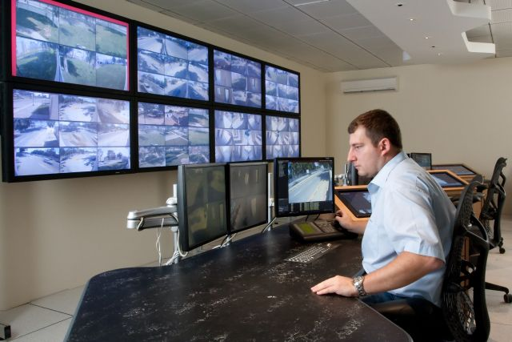
Remote client and TV wall matrix
Remote CMS Monitor can manage more than 3000 NVR servers
Centralization account and authority management
Different levels users for operation and available playback video control
Support TV Wall matrix
Control up to 120 monitors
simultaneously
Notes:
22

Slide 23
Surveon Solution Advantages
The only in house design camera, NVR and Storage devices provider in surveillance industry
End to End full integration. Performance and stability complete examination
Optimize and enhancement for high definition Management and recording
Design for NVR and Storage not simply outsourcing COTS solution bundle with software
High quality Megapixel HD Cameras and enterprise CMS software
15 years Taiwan company, worldwide customers and products
Full product line Industrial components and 3 year product warranty
Notes:
23

Slide 24
Question and Answer
Notes:
24

