Slide 1
Education Surveillance HD Solution
-Surveon Technology
Sales & Marketing Department
Surveon Technology, 2013

Slide 2
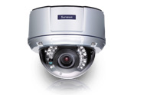

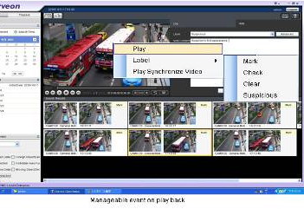
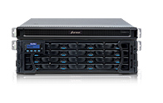
Education Surveillance HD Solution
Megapixel HD IP camera
Video Surveillance Storage
Video Surveillance Storage

Slide 3
Education Surveillance key objectives
With campus security incidents continue to occur, “Safe Campus” security installation and construction has been started gradually. In campus key and main sites security and protection has great importance as to school development and progress. In school where has a high volume of people flow that can’t let schools be isolated from dominant and hidden dangers which came from public society. Therefore, to strengthen anti-intrusion, anti-theft, anti-sabotage, fire, riot and security checks, and establishing support for anti-theft alarm security systems, personnel and miscellaneous social stream molecules up to no a strong deterrent and shock effect, has been proof to be effective prevention tool.
Front-end and back-end storage solutions camera selection determines the project's economic and reliability, and platform software architecture has decided the openness of a third-party interface and system scalability limit. Surveon with all in-house desgin from the camera to the storage and production capacity with more than 15 years in the storage and security projects accumulated strength, providing our partners a truly complete and highly reliable solutions on surveillance projects

Slide 4
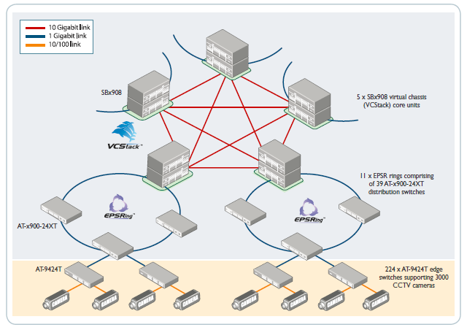

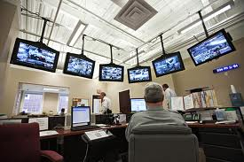

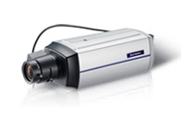
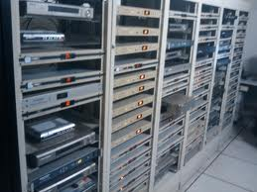
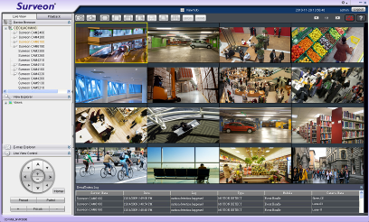
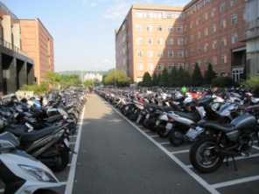
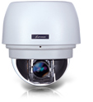
Enterprise-Level Client-Server video Solutions
IP SAN
Campus security center
Division monitor
Education area monitor
Other area monitor
education
Lab
Computer center
Gate
Corridor
Sidewalks
Parking
…
Local monitor A
Local monitor B
Notes:
4

Slide 5
Security Key Areas of Educations
 | Main scene
Education area | Education buildings, labs, computer center
Administrative area | office buildings, lobby, administrative center
Living Area | Restaurants, stadium, library , dormitory
Others | Main Gate, corridors , sidewalks, parking lot , elevators

Slide 6
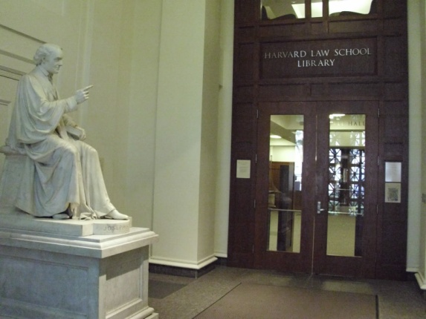
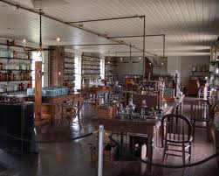
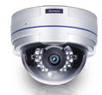
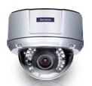
Education Area HD cameras installation key areas
Education building
Laboratory
Computer Center
Access control and protection adopts Wide angle HD VI
camera CAM2311
Building surveillance
adopts HD Vari-focal camera
CAM4311
Lab access control and security adopts Vandal Proof HD Dome
CAM4361
Notes:
6

Slide 7
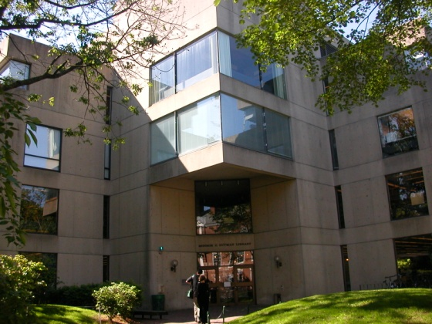
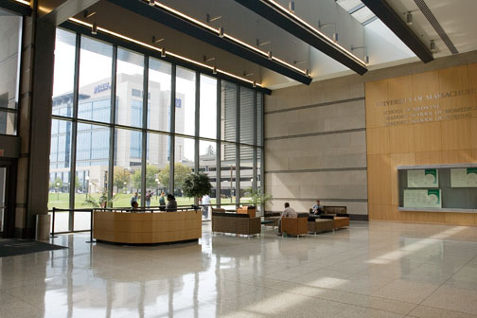

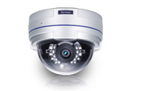
Administrative area HD camera key installation areas
Office building
Lobby
Administrative Center
Outdoor Monitor
Vandal Proof HD Dome
CAM4361
Access control and protection adopts Wide angle HD VI
camera CAM2311
Access control adopts HD Vari-focal camera
CAM4311
Notes:
7

Slide 8
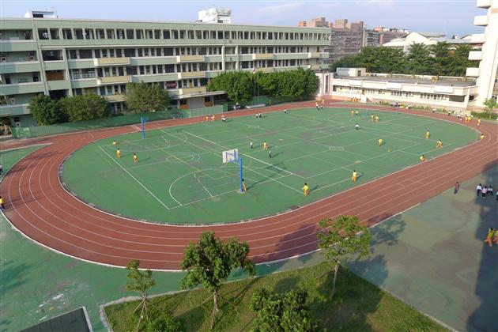

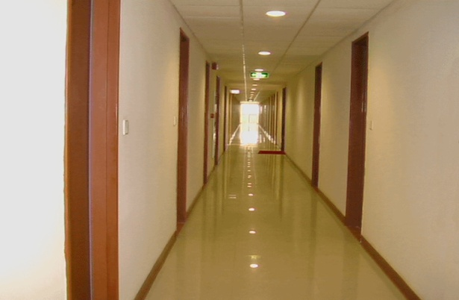
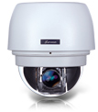
Living area HD cameras key installation areas
Stadium
Library
Dormitory
Stadium and playground surveillance adopts
HD 20X speed dome CAM6351
Librarian and collections
monitor adopts HD Vari-focal
Camera CAM4311
Corridors and Dorm monitor adopts Wide-angle box CAM2311
Notes:
8

Slide 9
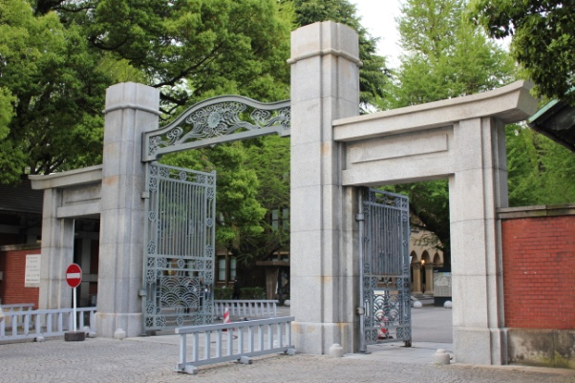
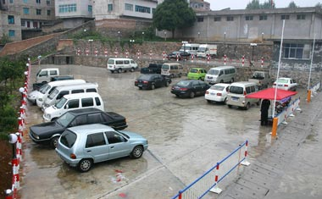
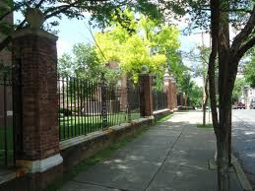
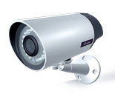
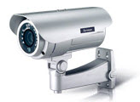
Others HD cameras installation key area
School Gate
Parking lot
Fence area
Around Gate and wide area HD IP66 IR Bullet
CAM3361
Outdoor Parking lot and surroundings monitor HD IP66 IR Bullet CAM3361
Outdoor fence area
HD IP66 IR Bullet
CAM3351
Notes:
9

Slide 10
Surveon Campus surveillance solution
 | Large Campus 100 - 500+ CH | Middle size Campus 50 – 100 CH | Small size Campus 50CH and below
Record system | Centralized storage IP SAN | DAS RAID system | Embedded RAID controller
VI and Database system | NVR2100 | NVR2100 | SMR8000
Client Management surveillance software | Surveon Client Enterprise software 2.4.8, Mobile client ,Browser client
CMS | Required, Manage multiple sites | Required, Manage multiple sites | Often not required, all in one
TV Wall Management | Required | Often not required | Not required
Client Management software | Surveon Client Enterprise software 2.4.8, Mobile client ,Browser client
Notes:
10

Slide 11
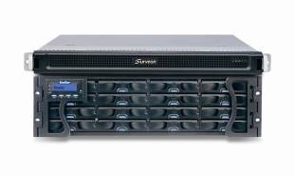
NVR2164 HD NVR
Industrial-level Xeon computing platform
Single NVR supports up to 64 cameras
full HD record
Each camera supports up to 1080P, 25 fps.
Support centralized storage IP SAN or DAS architecture
Scalable , supports up to 3000+ cameras in single domain
Complete End to End testing and certification
NVR2164 – 16B
Enterprise RIAD
Subsystem
Support maximum 480 TB
Enterprise-level RAID
Notes:
11

Slide 12
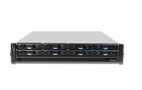
Small and medium-sized schools HD solution configuration - SMR8000 series
Support 16 – 40 Channels , Full HD Cameras video surveillance
Support up to 8 HHDD and Hardware
RAID protection
Rack mount and tower two solution
Virtual matrix , support up to 8 physical
monitors on single server
Support HTML integrated with View
Advance multi-layer E-Map
Client/Server Central management structure
Advance Event management record rule
SMR8040 Megapixel HD NVR
Notes:
12

Slide 13
CAM2311 HD Camera Series
Support H.264 compression with 1920 x 1080 @ 25 fps
Built-in SD Card support network supports failover and recovery
Independent ISP supports 3D noise reduction, WDR, multi-zone HLC, De-fog
Support standard RS-485,audio and DI/O control
Full Aluminum body, High stability and
performance thermal design
Advance Super Low Light enhancement mode
Supports full series 2M,3M and 5M solution
CAM2311 Series
Full HD Network Camera
Notes:
13

Slide 14
14
Enterprise Level Video Management Platform features Overview
- To meet your professional security project

Slide 15
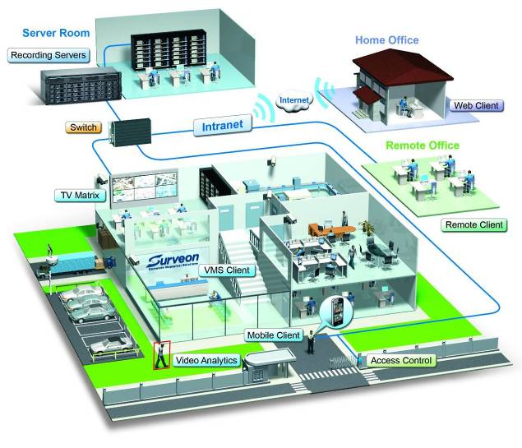
Distributed architecture of enterprise-level Video management platform
15
Module design
1. Record server
2. Domain Mgt. Server
3. VI Server
4. Client UI
5. Mobile Client
6. CMS client
Support 2000+ cameras monitor requirements, and can support multi-local and remote monitoring as well as TV Wall equipment

Slide 16
Versatile Live View mode
16
Virtual Matrix – More than 20 Views mode
Single client interface, including local and CMS client
Multi-level Active E-map
Supports HTML integration, Auto switch different Views , Stream Selection
Single client supports up to eight physical screen
Real-time playback, Video Bookmark
PTZ joystick , on screen PTZ control

Slide 17
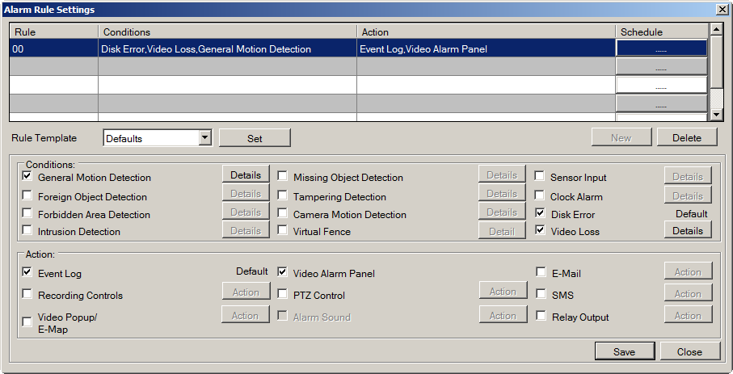
Advanced Alarm and Client Management
17
Multiple Alarm rules and schedule can be setup
Complete system management through client software
Multi-level user rights control
Client-Server, Domain management framework, all accounts, NVR centralized control
Advanced alarm configuration
Notes:
17
17

Slide 18

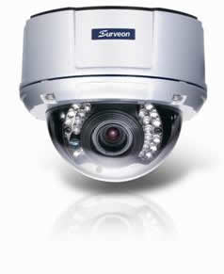
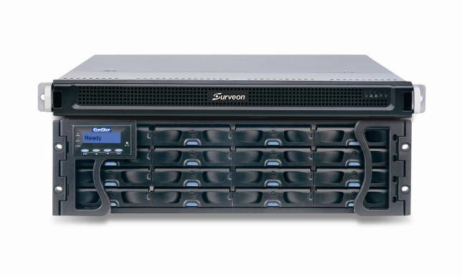
Recording Recovery for Offline
18
Record to camera SD card during network failure
Automatic resend the video to NVR
Automatic bandwidth control for resending video
Megapixel Camera
Megapixel RAID NVR
Video Management
Software
Prevent connection loss or cut off power connection by purpose

Slide 19
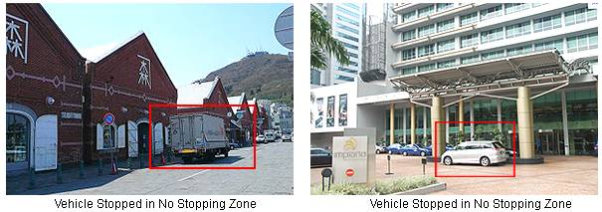
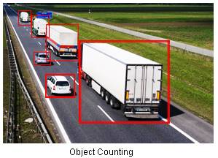
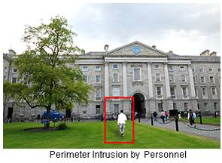
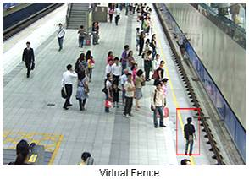
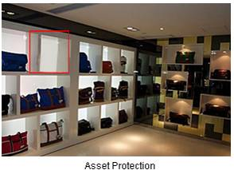
Real-time Video Analytics Engine
19

Slide 20
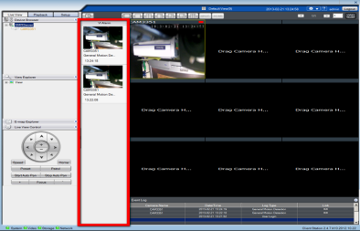
Investigation & Search
20
Real-time Video Alarm Panel Pop-up
Video Bookmark & Advanced Label-based Search
Sync and De-sync HD Video Playback
Multi Channel Video Backup
Mask and Watermark Control
Online and remote
Fast-forward and playback
Notes:
20
20

Slide 21
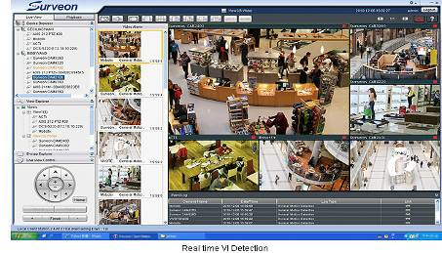
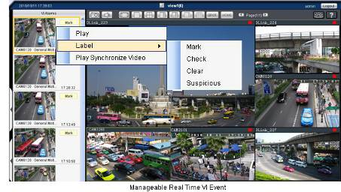
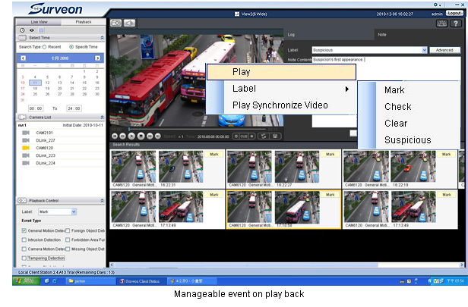
Actionable Monitoring & Smart Investigation
21
Instant View/PB VI Event
Video Clip Bookmark
Database Quick Event Query
Case Management
Notes:
Treplex design: live view, play back, and recording
Record by schedule, record by event
Playback smart investigation, search by event, search by VI
All the event will pop up from the window and the bodyguard can choose the action or come back to the logs later
VI engine
Design for scenarios

Slide 22
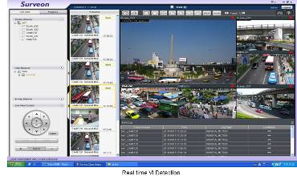
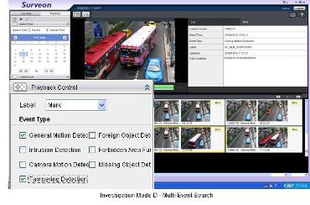
Local monitor mode and Active VI search
Support 1, 4, 5, 7, 9 – 32 View Auto Scan
Support local server Live View and playback
Support real time VI and alarm
Support advance alarm and trigger
Client/server central management infrastructure
Support remote control and playback
Advance Event management regulation
Notes:
22

Slide 23
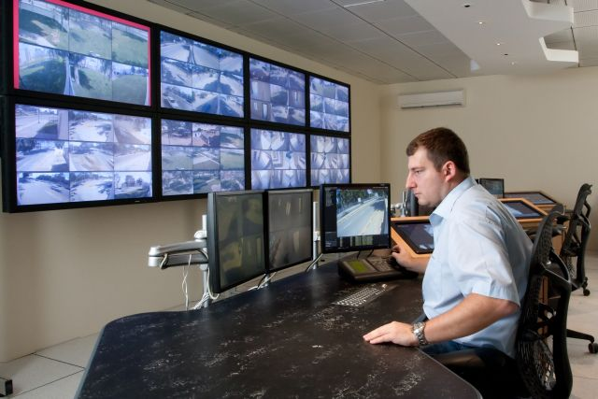
Remote client and TV wall matrix
Remote CMS Monitor can manage more than 3000 NVR servers
Centralization account and authority management
Different levels users for operation and available playback video control
Support TV Wall matrix
Control up to 120 monitors
simultaneously
Notes:
23

Slide 24
Challenges on Video Intelligence of Education
Prevent criminals invaded and implement abduction, theft, robbery and other illegal activities
Protect life and property safety of students and staffs.
Enhance campus safety inspection efforts and ability to respond to emergencies
Schools entrances are added into city surveillance monitoring areas
Notes:
24

Slide 25
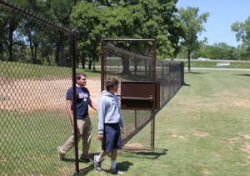
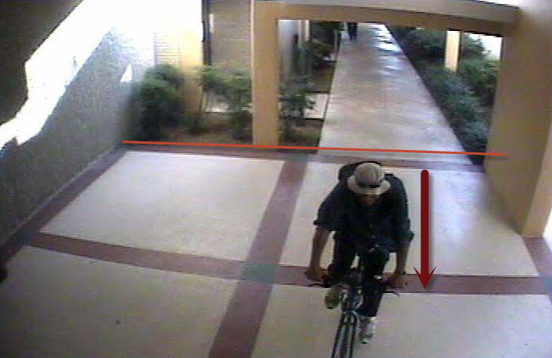
VI applications of Education I
Intrusion detection:
One way or two way real time detects intrusion and to alarm related parties
Virtual Fence:
To improve back doors or side doors security, virtual fence can be used to setup boundary and if any suspicious object step in will trigger alarm
Notes:
25

Slide 26
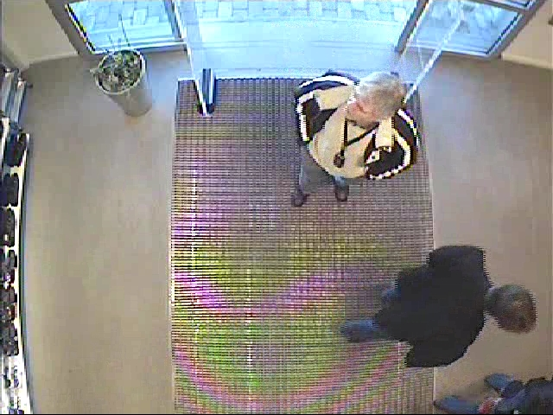
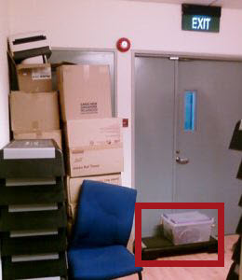
VI applications of Education II
Object counting:
One way or two way real time detects object incoming or outgoing of the restaurants or others stores in campus
Foreign object:
Be alerted to objects blocking emergency exits which has becoming importance when concerning of fire accidents, earthquakes or other accidents that need to evacuate students
Notes:
26

Slide 27
Surveon Solution Advantages
End to End full integration. Performance and stability complete examination
End to End 100% manufacture and production , Not outsourcing COTS solution
High quality Megapixel HD Cameras and enterprise CMS software
15 years Taiwan company, worldwide customers and products implementation
Full product line Industrial components and 3 year product warranty
Manufacture and made in Taiwan
Notes:
27

Slide 28
Question and Answer
Notes:
28

