Slide 1


Surveon Channel Marketing
Introduction
Sales & Marketing Department
Surveon Technology

Slide 2
Outline
2
About Channel Partners
Surveon Channel Partner Program
Surveon Partner Certification Program
Surveon Partner Marketing Program

Slide 3
3
NVR5000 Key Values
About Channel Partners

Slide 4
What is a Channel Partner?
4
A channel partner is a company that partners with a manufacturer or producer to market and sell the manufacturer's products, services, or technologies.
This is usually done through a co-branding relationship. Channel partners may be distributors, vendors, retailers, consultants, systems integrators (SI), technology deployment consultancies, and value-added resellers (VARs) and other such organizations.

Slide 5
Channel Player Value Chain
5
Manufacturer (Surveon) | Channel Partner (Disty/SI) | Customer (End User)
Product: provide innovated products and technology that meet the market demands and customer requests | Deploy Surveon products in the local market Understand Surveon products and differentiations from competitors Feedback customer demands to Surveon | Generate projects and product demands
Marketing: provide a variety of marketing support to increase Surveon corporate branding and product awareness | Carry Surveon brand to the local market Utilize Surveon marketing support to promote products in the local market | Aware of Surveon brand and products Surveon deployment success cases
Technical: provide tech support, product training, RMA support | Get certified technical training Provide services and support to customers | Report technical issues to Channel Partner
Sales: provide product, solution packages, price strategy, delivery, and relationship liaison | Sell Surveon products in the local market Spec-in Surveon products in the local projects.

Slide 6
Channel Partner Marketing Activity
6
How can Partner promote Surveon in the local market?
Website | e-Marketing | Training | Local Event | Local Media | Others
Surveon logo, Product banner | Send regular e-news to customers promoting Surveon | Participate Surveon online/onsite training | Represent Surveon in local conferences | Buy print media ads promoting Surveon | Success project report
Surveon product: info, image, listing | Forward Surveon product e-blast / e-news to customers | Get certified to deploy Surveon products and provide services | Represent Surveon in local tradeshows | Buy online media banner promoting Surveon
Surveon collateral download: datasheet, brochure, leaflet |  |  | Hold seminars to promote Surveon products to customers
Surveon demo video
Hyperlink to Surveon website
Go to Page 19 (and onwards) to know more about Surveon marketing support and how to use it.

Slide 7
Channel Partner Yearly Marketing Plan (sample)
7
Year: 2015
Website | Topic | Detail | Online
Main Banner | Surveon retail solution | Solution key benefits, product image, features | 9/1
New Products | CAM4321LV, NVR3308, CAM4571 | Product listing, key features, images, | 7/31
Collaterals | Surveon retail solution | Brochure, selection guide, datasheet, leaflet | 8/15
Logo | Surveon company logo | with hyperlink to Surveon website | 3/4
e-News | Topic | Detail | Target
Monthly e-News | Retail solution | #1 position in the August e-news | 8/9
E-Blast | New product – retail solution | Solution key benefits, product image, features | 9/10
Media | Topic | Detail | Deadline
Online Banner | Complete 2 MP camera line | June – Sept banner, advertorial, product news | 5/30
Print Media | NVR + VMS solution | Bi-monthly ad for 3 issues (July - Dec) | 6/4
Event | Topic | Detail | Target
Local Event | Industrial Security Conference in xx city | Speech and booth | February
Tradeshow | ISC East | East region for Q4 | November
Seminar | Surveon VMS training | Invite SI/customer to learn VMS | May
Solution Day | Surveon total solutions | 1 day event: market, new product launch, demo, case, training | October

Slide 8
8
Surveon Channel Partner Program

Slide 9
Why Surveon Channel Partner Program?
9
Foster promising channel engagements.
Develop synergistic resource allocation strategies.
Ensure channel fairness and equity.
Ensure business growth for all partners

Slide 10



Surveon Partner Program Levels
10
 | Platinum Partners enjoy exclusive benefits and a privileged level of marketing, sales and technical support. Platinum partners have expert technical support capabilities, and actively promote Surveon products.
 | Surveon provides an exceptional benefits, marketing tools and support to its Gold Partners. Gold Partners have solid understanding in, and the ability to sell, a wide range of Surveon products.
 | Becoming a Channel Partner is the first step in your partnership with Surveon. Surveon provides our Channel Partners with ways to grow your business, with benefits such as Surveon Partner web pages and marketing materials.

Slide 11


Surveon Partner Requirements
11
 | Partner Requirement
1 | Purchasing commitment |  | Yearly | Quarterly
2 | Price protection | V | V | V
3 | Annual sales and marketing plan |  | V | V
4 | Training /event activities for Surveon |  | V | V
5 | Present Surveon products at local exhibitions |  |  | V
6 | Carry full Surveon product line |  | 60% Models | 85% Models
7 | Provide local technical support | V | V | V
8 | Surveon certified sales rep |  | V | V
9 | Surveon certified technician(s) |  | V | V
10 | Provide Surveon site/ project references |  | V | V
11 | Register products to avoid channel conflicts | V | V | V
12 | Keep Surveon inventory |  | V | V
13 | Sign official partnership agreement |  | V | V
14 | List Surveon as a partner on website | V | V | V
15 | Provide a Surveon product page on website |  | V | V

Slide 12


Surveon Partner Benefits
12
Sales Support
1 | Surveon provided sales leads | V | V | V
2 | Special price support for strategic projects | V | V | V
3 | Credit term |  | V | V
4 | Dedicated sales representative | V | V | V
Marketing Support
5 | Local exhibition sponsorship |  | V | V
6 | Local training/event sponsorship | V | V | V
7 | Training/event standard package |  | V | V
8 | Marketing materials | Limited | V | V
9 | Special promotion projects |  | V | V
10 | Partner Recognition Certificate | V | V | V
Technical Support
11 | Dedicated technical support staff | V | V | V
12 | Dedicated RMA support | V | V | V
13 | Product/ technical training and seminars | Web-based | Onsite | Onsite
*All benefits granted upon Surveon approval.

Slide 13
13
Surveon Partner Certification Program

Slide 14
Surveon Partner Certification Program
14
Surveon Certification Program (MSCP) is to enable Surveon’s partners with professional knowledge for promoting Surveon’s complete megapixel solutions.
The MSCP includes a series of training courses and certifications from IP video basics, business correspondence, product details, to technical support. All Surveon partners should have a specified number of people complete the Sales and Technical Certifications.

Slide 15
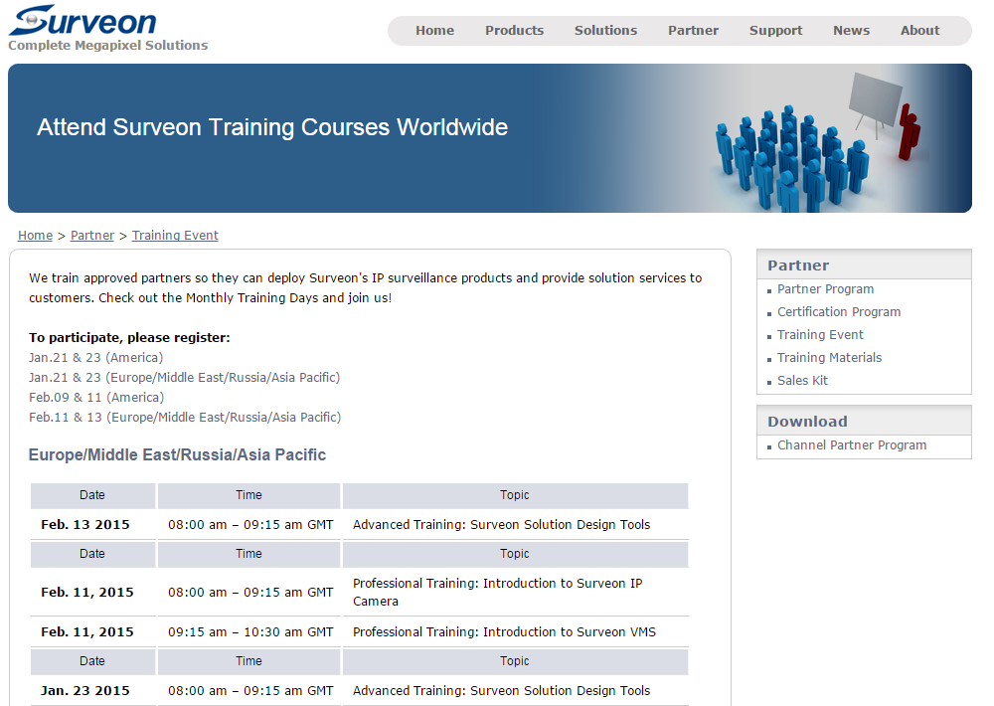
Surveon Partner Online Training Events
15

Slide 16
Surveon Partner Training Program - 1
16
Surveon Certification Course – Basic
Course Code | Topic | Targeted Trainee | Time (Hours)
MSCP-BA01 | IP Surveillance Basic | All | 2
MSCP-BA02 | Surveon Market Position | All | 2
MSCP-BB01 | IP Camera Basic | All | 2
MSCP-BB02 | Surveon IP Camera Introduction | All | 2
MSCP-BC01 | Video Management Software Basic | All | 2
MSCP-BC02 | Surveon VMS Introduction | All | 2
Surveon Certification Course – Business
Course Code | Topic | Targeted Trainee | Time (Hours)
MSCP-SA01 | Surveon Complete Megapixel Solutions | Product / Sales Manager | 2
MSCP-SA02 | Product Feature Highlights | Product / Sales Manager | 2
MSCP-SA03 | Megapixel Video Solution Design | Product / Sales Manager | 2
Surveon Certification Course – Technical
Course Code | Topic | Targeted Trainee | Time (Hours)
MSCP-TA01 | IP Camera Advanced | Technical Support / Manager | 3
MSCP-TA02 | VMS & NVR Advanced | Technical Support / Manager | 3
MSCP-TA03 | Solution Design | Technical Support / Manager | 3
MSCP-TA04 | Solution Practice | Technical Support / Manager | 3

Slide 17
Surveon Partner Training Program - 2
17
MSCP Certification
Level | Capability
MSCP Basic Level | Understand how the surveillance industry has developed Understand the basic elements of a surveillance system Understand the basic technical structure of an IP Camera Understand the basic technical structure of VMS Understand basics of new product design and product selection Understand Surveon’s market positioning and focus
MSCP Business Level | Possess all capabilities defined in the MSCP Basic Level Understand all product lineups of Surveon Familiar with the selling points of Surveon products Capable of selecting appropriate Surveon products Capable of designing basic solutions for Surveon products Familiar with basic VMS & IP Camera operations
MSCP Technical Level | Possess all capabilities defined in the MSCP Basic Level Familiar with technical parameters in Surveon IP Cameras Familiar with technical parameters in Surveon VMS/NVR Capable of designing advanced solutions for Surveon products Capable of configuring basic storage RAID systems

Slide 18
Surveon Partner Training Program - 3
18
MSCP Certification Requirement
Partner Level | MSCP Requirement
 | 2 x MSCP Basic Level
 | 2 x MSCP Business Level 3 x MSCP Technical Level
 | 3 x MSCP Business Level 6 x MSCP Technical Level

Slide 19
19
Surveon Partner Marketing Program

Slide 20
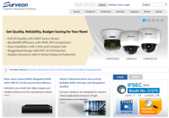

Surveon Partner Marketing Support
20
Website / e-Marketing
Print Collaterals
Product Marketing Materials
Event Marketing Materials

Slide 21
21
Website / e-Marketing

Slide 22

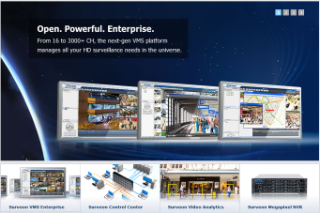
Surveon Corporate Website
22
Complete information about Surveon company, products, solutions, partner program, support and more.
Access to product documentations (datasheet, quick installation guide, manual, etc.) and resources (product image, brochure, selection guide, etc.)
URL: http://www.surveon.com/index.asp
VMS Microsite: http://www.surveon.com/vms/index.asp

Slide 23

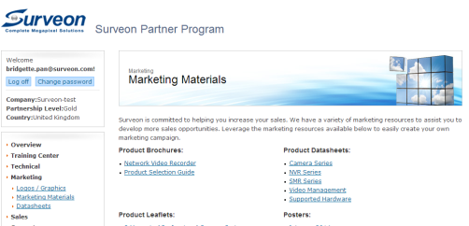
MySurveon Partner Zone
23
One location to access channel marketing materials, including all material (source files), test reports, SDK, and more.
URL: http://www.surveon.com/MySurveon/
Registration and login required.

Slide 24
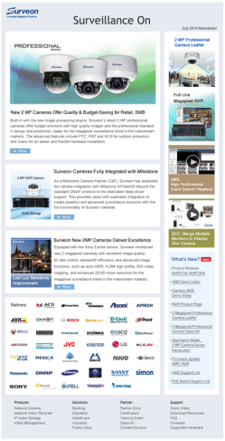
E-Newsletter
24
Monthly release to provide:
  New product solutions and key features.
  Latest updates on Surveon company, products, training, partner program, and more.
Partner can use the content for their own newsletters, or simply forward the e-News to Customers.
Location:
http://www.surveon.com/news/news.asp
http://www.surveon.com/news/newsletter.asp

Slide 25
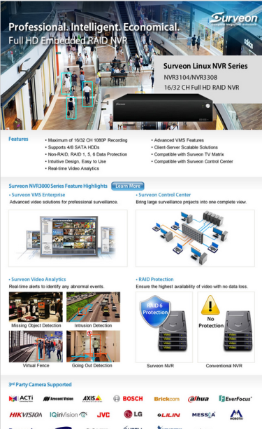
E-Blast
25
Promote Surveon featured product series, such as 2 Megapixel Professional Camera Series, NVR3000 Linux NVR Series.
Easy for Partners to forward (e-mail) to Customers for new product promotion.
Location: http://www.surveon.com/support/download-res.asp

Slide 26
26
Print Collaterals

Slide 27
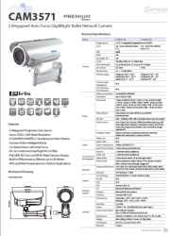
Product Catalogue
27
Complete collection of Surveon product models with detailed specifications.
A 60+ page booklet ready for Partners to refer to when considering Surveon camera, NVR, VMS, storage lines.
Print & PDF versions available.
PDF:
http://www.surveon.com/support/download-res.asp
Print copy: contact sales.

Slide 28
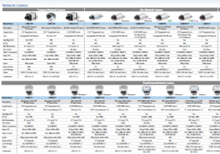
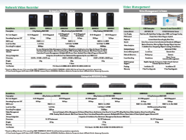
Product Selection Guide
28
Quick reference of Surveon product models
with key specifications.
Easy tables for Partners to refer to when
introducing Surveon Camera, NVR, VMS, Storage
lines to Customers.
Print & PDF versions available.
PDF:
http://www.surveon.com/support/download-res.asp
Print copy: contact sales.

Slide 29

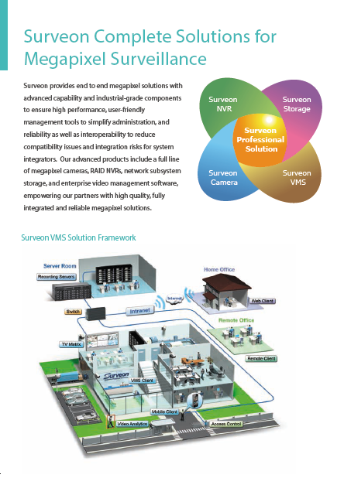
NVR Product Brochure
29
Introduction of Surveon NVR product line and VMS.
A booklet for Partners/Customers to have general understanding of Surveon NVR product series, vertical applications, and VMS features.
Print & PDF versions available.
PDF:
http://www.surveon.com/support/download-res.asp
Print copy: contact sales.

Slide 30

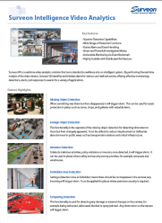
Product Leaflet
30
One sheet highlighting Surveon featured product:
  Megapixel Camera Series
  NVR Series
  Video Analytics
Easy for Partners to use at meetings and tradeshow.
Print & PDF versions available.
PDF:
http://www.surveon.com/support/download-res.asp
Print copy: contact sales.

Slide 31

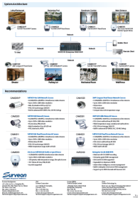
Vertical Market Leaflet
31
One sheet offering Surveon solution packages for different vertical markets:
Easy for Partners to refer to when selecting Surveon products for different applications.
PDF versions available.
PDF:
http://www.surveon.com/support/download-res.asp

Slide 32

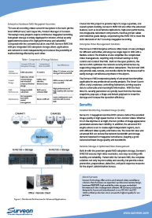
Success Case
32
Surveon successful installments around the world in different applications, such as Banking, Border & Port, Education, Healthcare, Industrial, Public Utilities, Retail, and City Surveillance.
Easy for Partners to refer to when choosing Surveon for projects.
PDF versions available.
PDF:
http://www.surveon.com/support/download-res.asp

Slide 33
33
Product Marketing Materials

Slide 34
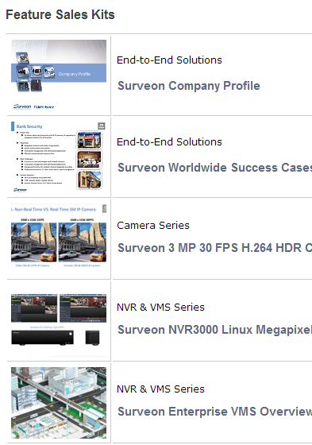
Sales Kit
34
Each sales kit offers in-depth content on product, feature comparison, market trends, vertical solutions and more.
Ready for Partners to study Surveon products, share with Customers and use for sales presentation and events.
PowerPoint version available.
Location:
http://www.surveon.com/Partner/Sales-kit.asp

Slide 35
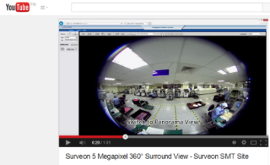
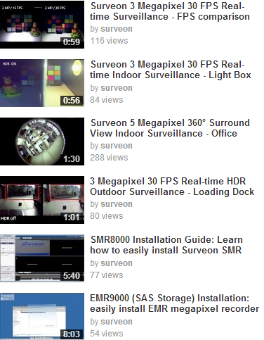
Demo Video
35
Over 50 demo videos of cameras, NVR,
SMR, VMS, SCC.
Watch and get better understanding of Surveon products, from installation, product features to hands-on operation.
YouTube & Download files available.
Location: http://www.surveon.com/support/Video.asp
YouTube Surveon Channel: https://www.youtube.com/user/surveon/videos

Slide 36
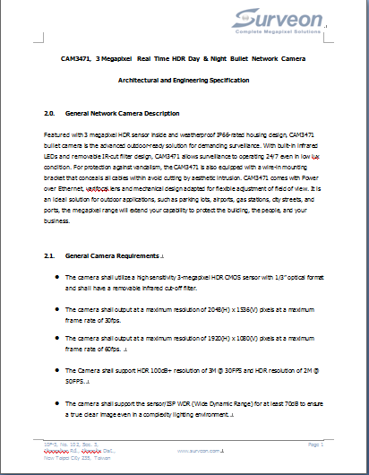
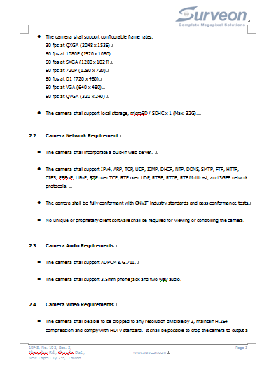
A & E Specifications
36
Each A&E Spec enlisted product specifications and highlighted functions for different models.
Partners can easily refer to for the chosen models to match the tender/project requirements.
Word version available.
Download in each product page
(under Documentation).

Slide 37
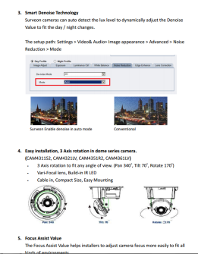
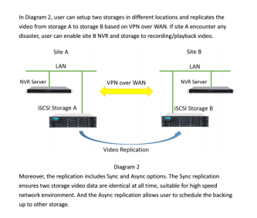
Application Notes
37
In-depth technical documents to explain Surveon key product functions and applications.
Guidelines for Partner to understand and deploy Surveon products.
PDF version available.
Location: http://www.surveon.com/support/application.asp

Slide 38
38
Event Marketing Materials

Slide 39
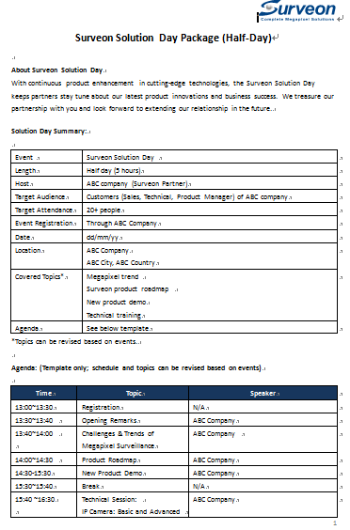
Event Package
39
An easy to follow guide for Partners to organize a Surveon event in their area.
Can be customized into different types: a seminar, workshop or training course.
Half day, 1 or 2 day format available.
PDF version available.

Slide 40
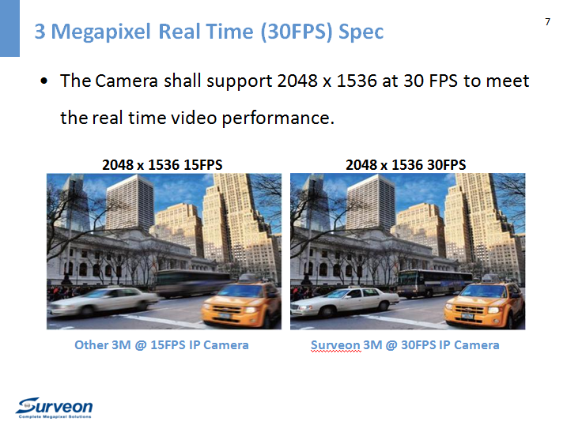
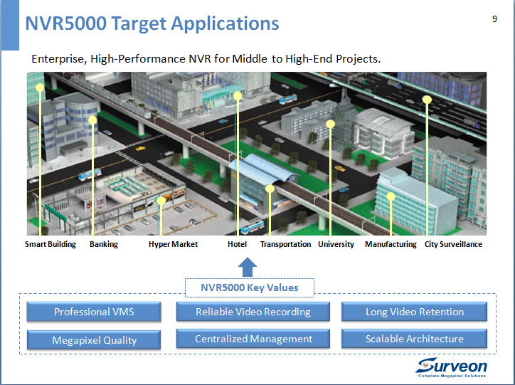
Event Presentation PPT
40
Customized presentation PPT for Partners to deliver the important info (Surveon company, product, market) to the audience.
Designed to increase Surveon branding and product awareness.
PPT version available.
Training for presentation content available.
Contact Sales for requests.

Slide 41
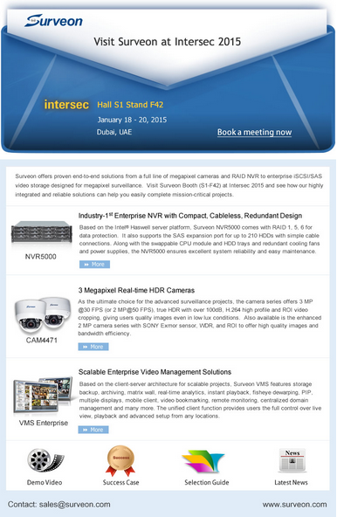
Event e-Invite/Thank You Note
41
Customized tradeshow or event invitation (and thank you note) ready for Partners to send to their customers.
Designed to increase Surveon branding and professional image.
E-file version available.
Contact Sales for requests.

Slide 42
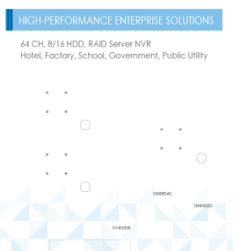

Event Poster
42
Customized tradeshow or event poster design for Partners to use in their events.
Designed to increase Surveon branding and professional image.
Wall posters, banners, and roll up posters
Design-ready (file) version available.
Contact Sales for requests.

Slide 43


Event Giveaway
43
Surveon branded giveaway items for Partners to use in the events.
Designed to increase Surveon branding and professional image.
LED pens, polo shirts available.
Contact Sales for requests.

Slide 44
44
Questions & Answers

Slide 45
45
More Info About Surveon Solutions
www.surveon.com
sales@surveon.com

