Slide 1
City Surveillance Solution
-Surveon Technology
Sales & Marketing Department
Surveon Technology, 2013

Slide 2
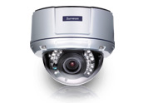

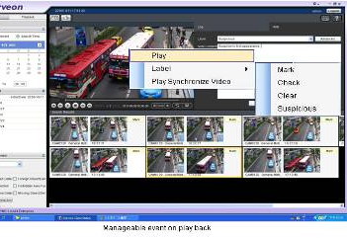
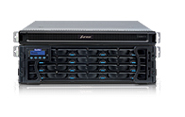
Surveon Technology City Surveillance Solution
Megapixel HD IP camera
Enterprise Level VMS Solution
Video Surveillance Storage

Slide 3
City Surveillance key objectives
Video and network technology development for urban development network video surveillance provide a good foundation for improving social order, crack down on crime, protect the lives and property of citizens and other goals. City surveillance has become the most important security projects also geographic coverage and a wide range of thousands of cameras installation provisioning, makes city surveillance program put emphasis especially on the program's integrity, economy and reliability. Other than this, demand diversification and installation characteristics, forces the project selection must support scalability and openness.
Front end camera and the back-end storage solutions selection determines economic and reliability of the entire project, software platform architecture determines the limit of third-party open interfaces and system expansion. Surveon with all in-house design from the camera to the storage production capacity of more than 15 years in the storage and security projects accumulated strength, provides our partners a truly complete and highly reliable solution. Surveon enterprise-level client-server architecture management software can help integrators resolve the openness and scalability needs.

Slide 4
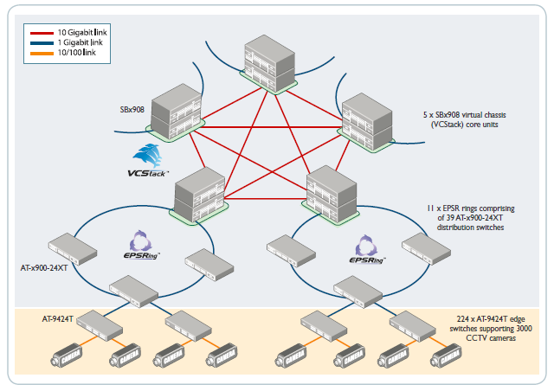
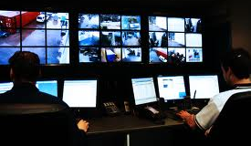

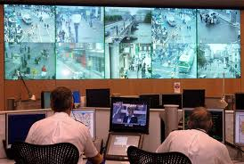
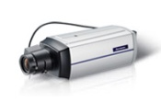
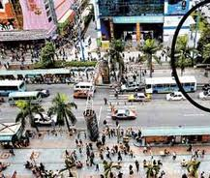
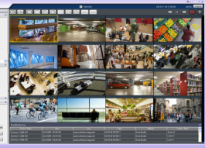
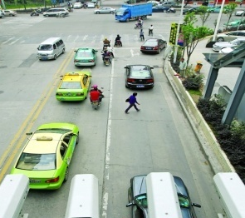
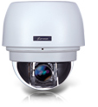
Surveon - Enterprise-Level Client-Server video Solutions
IP SAN
central public security level 1 command center
Area monitoring & relevant administrative departments
Area monitor
Road monitor
Cell
Important
sites
Government
Public areas
Violation
Capture
Case retrieve
Case tracking
Traffic manage
…
Local area monitor
Local area monitor
Notes:
4

Slide 5
Surveon City Surveillance Solution
 | Small Area 500 - 1000 channels | Medium Area 1000 - 3000 channels | Large scale Area 3000+ channels (separate area)
Record storage system | IP SAN EonStor iSCSI series | IP SAN EonStor iSCSI series | IP SAN or Fiber SAN EonStor series
VI and database system | NVR2164 | NVR2164 | NVR2164
Client management and monitor software | Surveon Enterprise software 2.4.8, mobile client browser client
Central Management Software | Required. Standard model can support multiple NVR | Required. Standard model can support multiple NVR | Required. Standard model can support multiple NVR
SDK | Surveon NVR SDK | Surveon NVR SDK | Surveon NVR SDK
TV Wall | Yes | Yes | Yes
Cameras | 2M Box type, 3M Box type, 5M Box type, 2M intersection box type,2M Speed Dome
Notes:
5

Slide 6
Surveon City surveillance standard 128 channels package
City surveillance standard program package applications
 | Cameras | Record days | Daily record hour | Frame rate and bit rate
Project included | 128 Full HD cameras | 30 days | 24 hours | 25 FPS @ 6Mbps
Note | This program has been validated over hundreds of hours of complete end-to-end verification from the camera, NVR storage and practical application to the global security projects
City surveillance standard program package contains devices
 | Storage | Cameras | HD NVR | Software package
Project included | 7 x EonStor IP SAN | 128 x CAM2311 | 2 x NVR2164 | CMS,TV wall, clients, management software
Note | Not included client PC and TV wall matrix hardware
Notes:
6

Slide 7
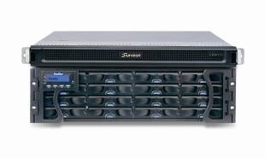
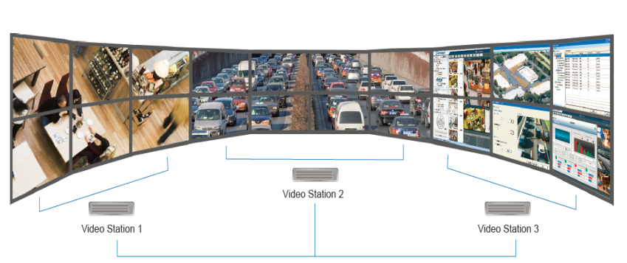

128 channels program package, high scalability
128 cameras
256 cameras
3000 + cameras
…
Including cameras, NVR, RAID.30 days 24 hours video
Including cameras, NVR, RAID.30 days 24 hours video
Including cameras, NVR, RAID.30 days 24 hours video
Supports online extension to be added and controlled under same domain server & CMS
TV wall and matrix client can extend unlimited
Notes:
7

Slide 8
Storage requirements configuration
28 HD cameras & 30 days video
RAID 6 or RAID5 + 1
HDD Size | Enclosure | Number of Disk | Number of Enclosure
1TB | 12 Bay | 345 | 29
1TB | 16 Bay | 329 | 21
2TB | 12 Bay | 174 | 15
2TB | 16 Bay | 166 | 11
3TB | 12 Bay | 116 | 10
3TB | 16 Bay | 110 | 7
4TB | 12 Bay | 88 | 8
4TB | 16 Bay | 84 | 6
RAID 5
HDD Size | Enclosure | Number of Disk | Number of Enclosure
1TB | 12 Bay | 314 | 27
1TB | 16 Bay | 307 | 20
2TB | 12 Bay | 158 | 14
2TB | 16 Bay | 154 | 10
3TB | 12 Bay | 105 | 9
3TB | 16 Bay | 103 | 7
4TB | 12 Bay | 79 | 7
4TB | 16 Bay | 77 | 5
Included hard disk consumption and RAID configuration demand
Notes:
8

Slide 9
NVR2164 HD NVR
Industrial-level Xeon computing platform
Single NVR supports up to 64 cameras
full HD record
Each camera supports up to 1080P, 25 fps.
Support centralized storage IP SAN or DAS architecture
Scalable , supports up to 3000+ cameras in single domain
Complete End to End testing and certification
NVR2164 – 16B
Enterprise RIAD
Subsystem
Support maximum 480 TB
Enterprise-level RAID
Notes:
9

Slide 10
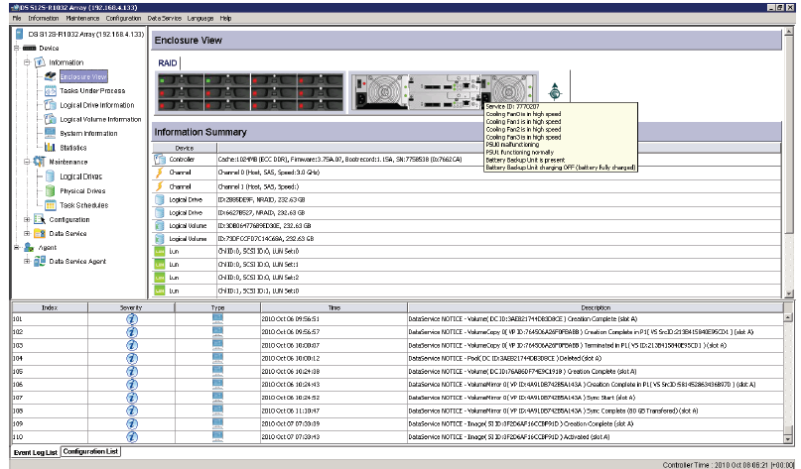
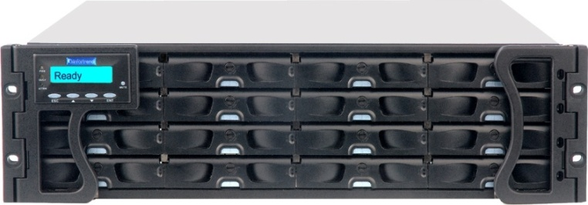
EonStor High Performance iSCSI Storage
Over 200,000 installation worldwide
High-performance controller: RISC Power PC - not X 86 architecture
High stability: own ASIC chip - dedicated RTOS, not Linux standard program
Remote management and control, advanced storage features: off-site backup, virtualization
Support up to 112 HDD(2, 3, 4TB)
Fully modular wired-less design - best seismic, thermal design
SANWatch Control Software
ESDS Series
Notes:
10

Slide 11
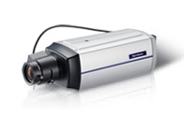
CAM2311 HD Camera Series
Support H.264 compression with 1920 x 1080 @ 25 fps
Built-in SD Card support network supports failover and recovery
Independent ISP supports 3D noise reduction, WDR, multi-zone HLC, De-fog
Support standard RS-485,audio and DI/O control
Full Aluminum body, High stability and
performance thermal design
Advance Super Low Light enhancement mode
Supports full series 2M,3M and 5M solution
CAM2311 Series
Full HD Network Camera
Notes:
11

Slide 12
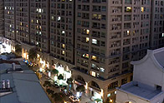

Video example - low light traffic effect and the strengthening of low light condition
Low light license plate example
http://v.youku.com/v_show/id_XNTM5MzU3NzQ4.html
Extremely low light enhancement example
http://v.youku.com/v_show/id_XNTM5MzE0OTg0.html
Notes:
12

Slide 13
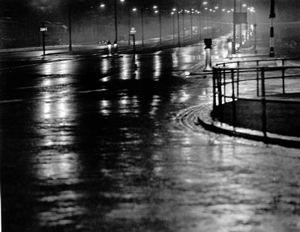

Multi-channels HLC @ city surveillance application
Suitable for intersection installation and could setup up to four separate areas for HLC control
Notes:
13

Slide 14
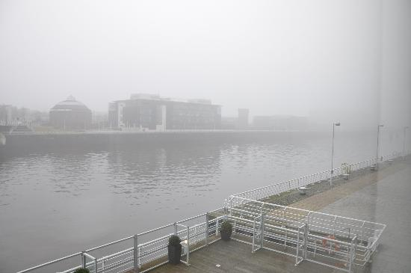
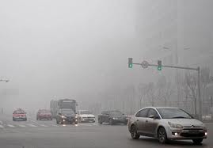
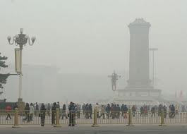
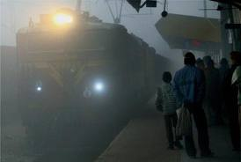
Auto De-fog
River / Port Monitoring
Traffic Monitoring
Public Utility / Facility
Rail Way / RailRoad Monitoring
Notes:
14

Slide 15
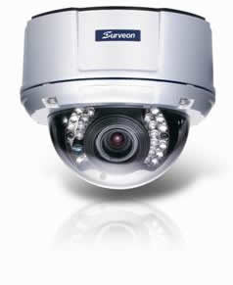

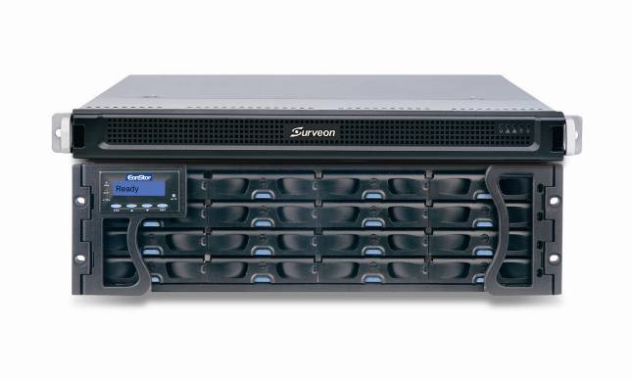
Recording Recovery for Offline
15
Record to camera SD card during network failure
Automatic bandwidth control for resending video, preventing influencing live video streaming
Front End Megapixel Camera
NVR2164 - RAID NVR
Video Management
Software
Suitable for large-scale cross-network city surveillance project

Slide 16
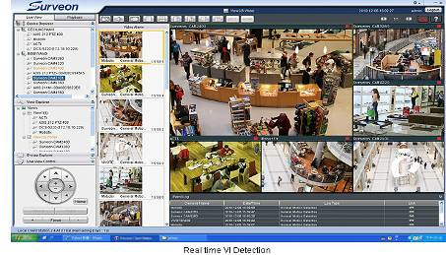
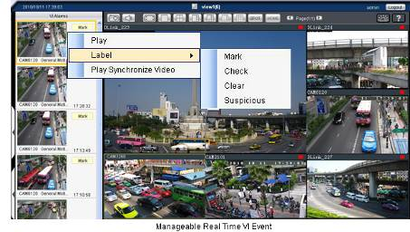
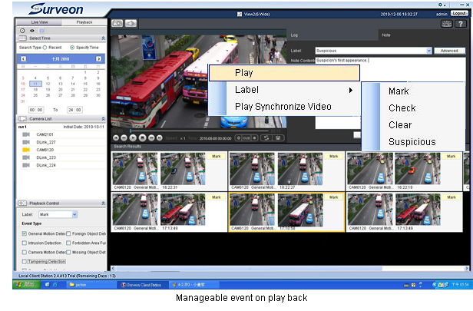
Actionable Monitoring & Smart Investigation
16
事件影像自动弹出
Instant View/PB VI Event
事件影像标记
Video Clip Bookmark
数据库快速搜寻
Database Quick Event Query
Case Management
案件管理

Slide 17
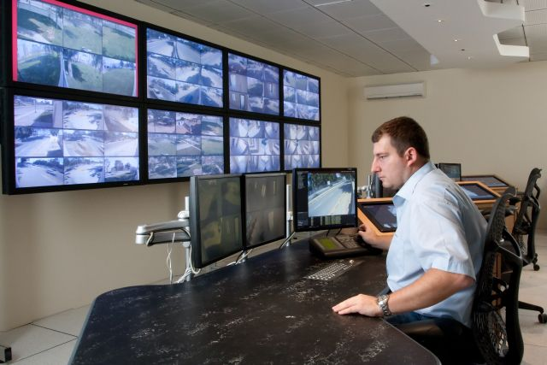
Remote client and TV wall matrix
Remote CMS Monitor can manage more than 3000 NVR servers
Centralization account and authority management
Different levels users for operation and available playback video control
Support TV Wall matrix
Control up to 120 monitors
simultaneously
Notes:
17

Slide 18
Challenges of Video Intelligence of City Surveillance
Real-time Detection of Perimeter Intrusion & Secure Zone Breaches
Detect Unattended Objects
Identify Suspicious Activity
Increase public safety
Accelerate emergency response
Reduce Crime
Improve quality of life
Notes:
18

Slide 19
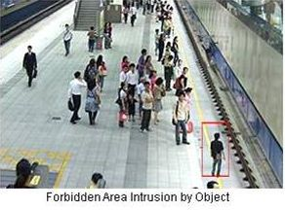
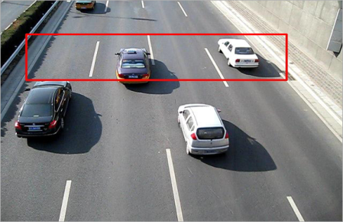
VI applications of City Surveillance I
Forbidden area:
People that enter preset forbidden area will trigger alarm to inform security guard to help evacuate the area
Traffic Violations(TBD):
Detect exceptions to the general traffic flow to ensure smooth movement
Measure traffic flow (major intersections, adjacent roads) to enable better planning to avoid congestion, improve traffic flow and maintain clear access points
Notes:
19

Slide 20
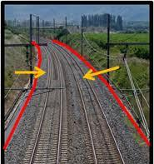
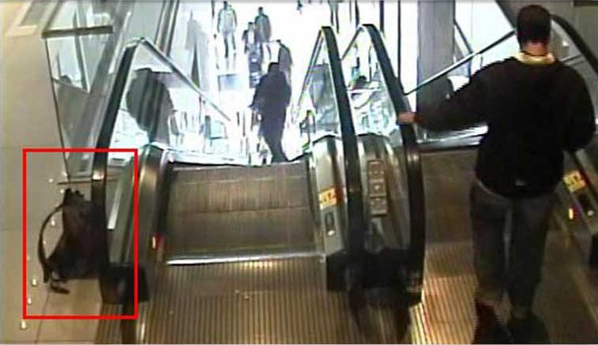
VI applications of City Surveillance II
Intrusion Detection:
Be alerted to people or vehicles and other objects that shall not on train tracks or in restricted areas
Foreign object:
Identify suspicious parcels or objects that suddenly appear in preset restricted area
Notes:
20

Slide 21
Case Study
Notes:
21

Slide 22
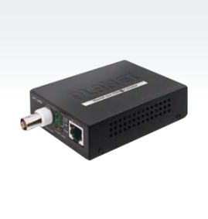
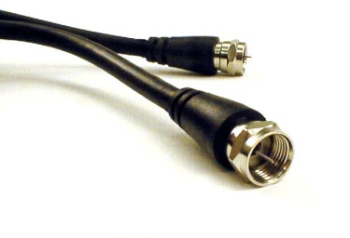
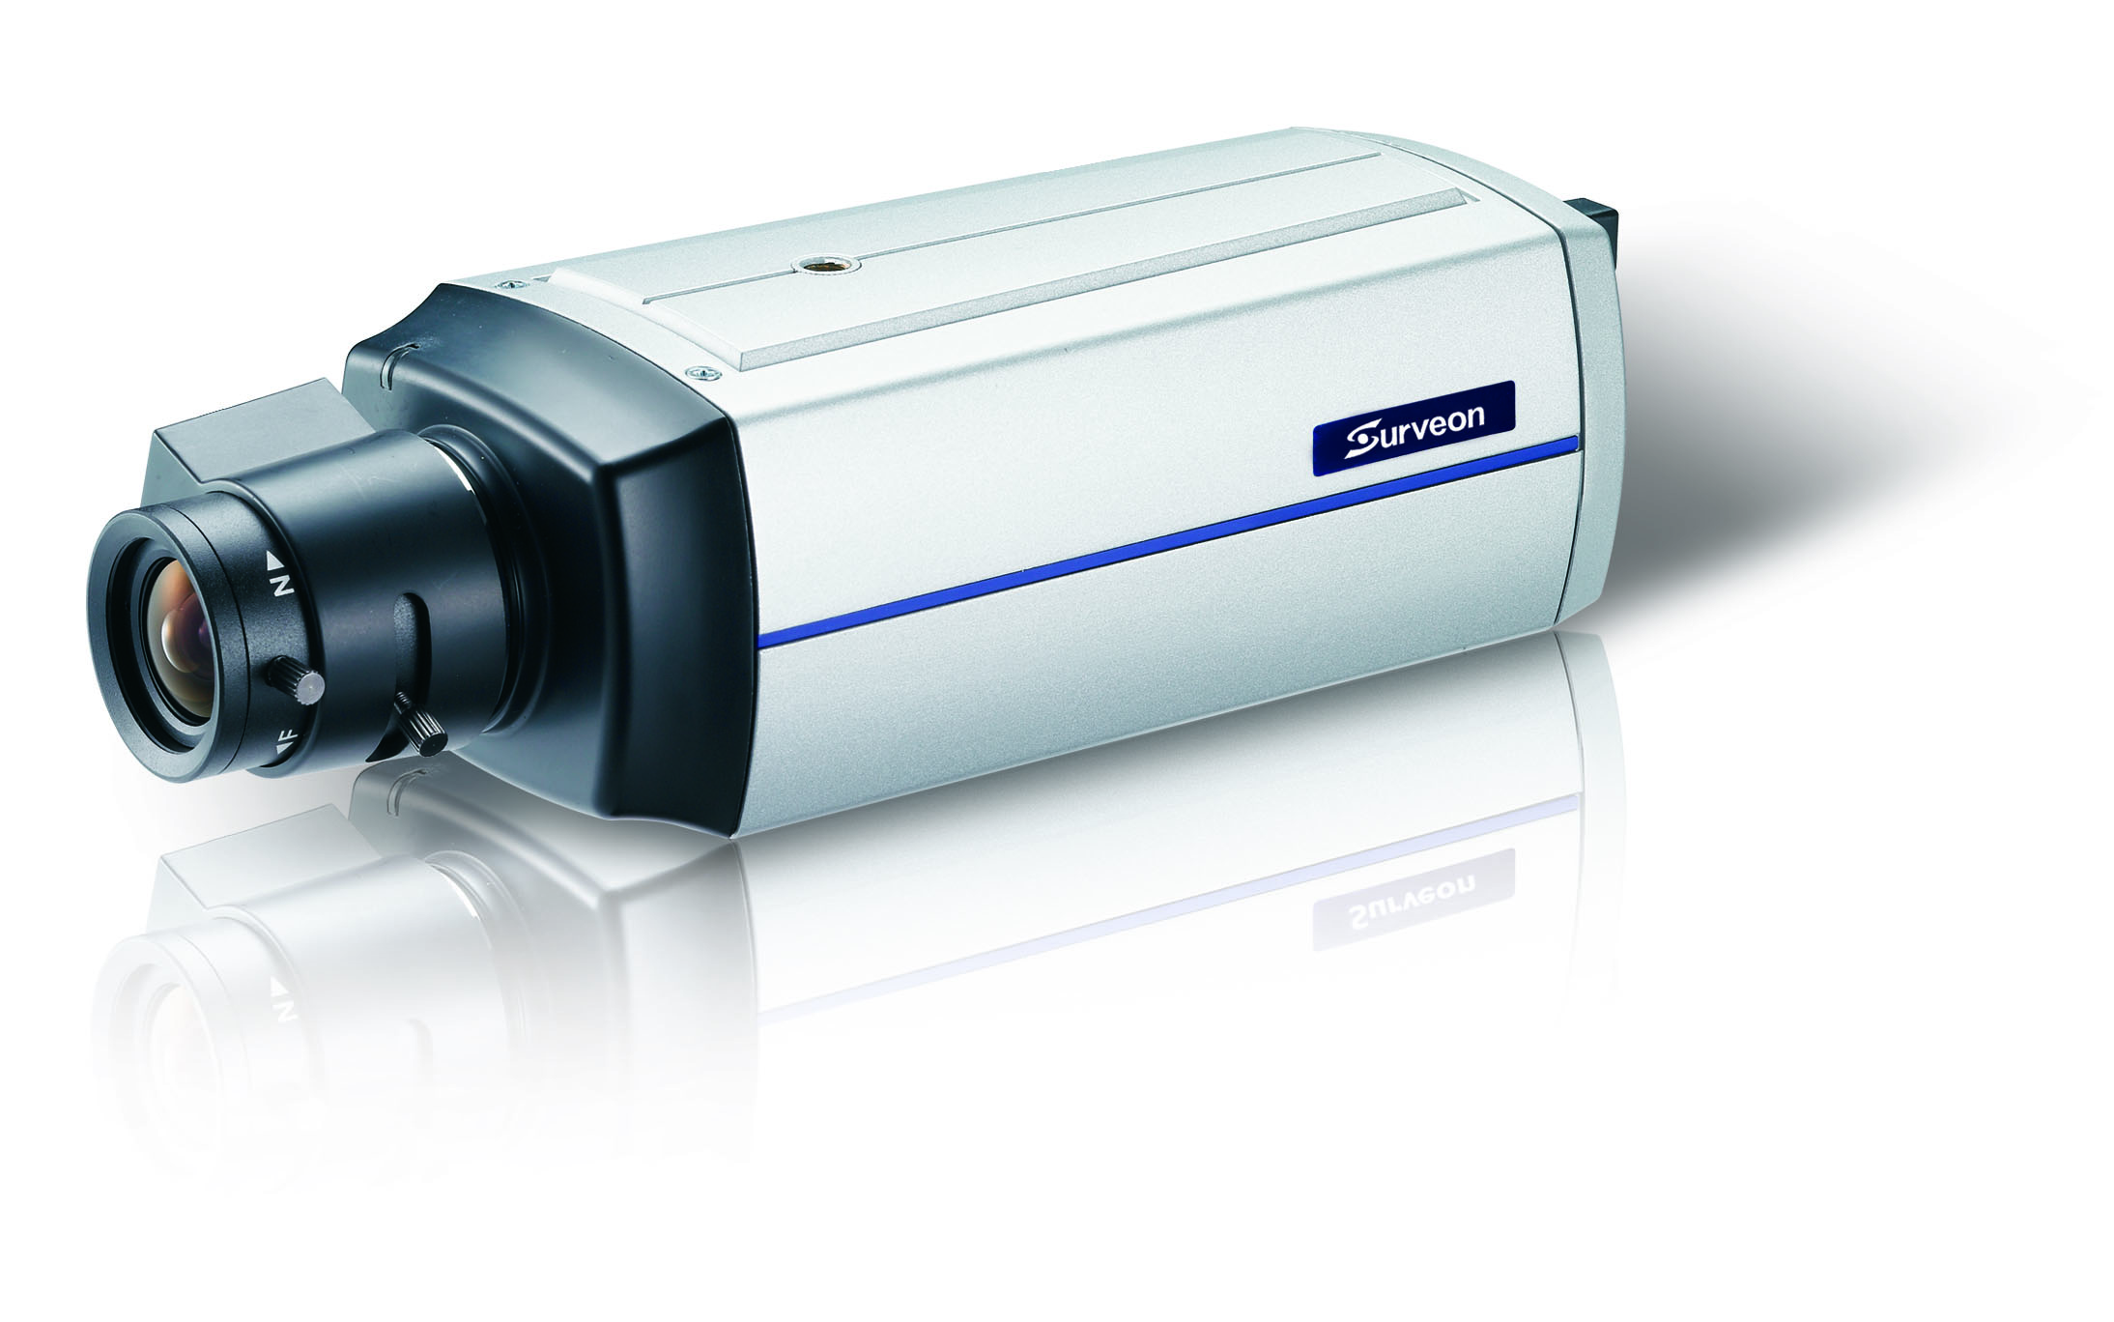
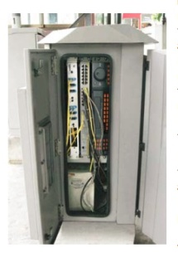
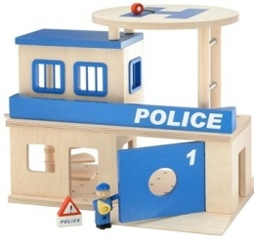
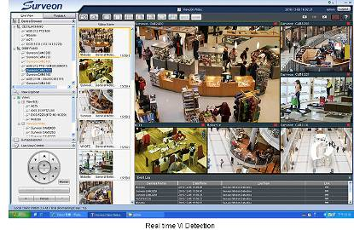
3000 channels City surveillance project – Asia
Front end 3000 x CAM2311 cameras + Network-to-coax equipment
1000 M, RJ45
Two hundred small areas, each area of up to 16 cameras connected to junction box containing switches and other equipment of Receiver
Fiber
VPN
Connected to the central terminal control center via VPN
3-4 areas send to one centralized police station can be used for local monitoring

Slide 23

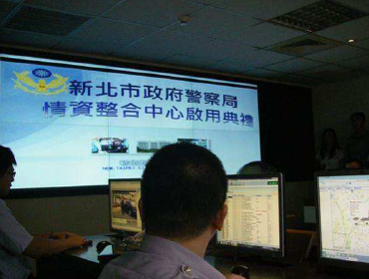
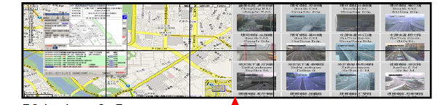
1500 channels New Taipei City City Surveillance Project
Front end 1500 x HD camera + standard network
RJ45 POE network
Public network via ADSL
VPN connection to police station
Public network through VPN
Central control by back-end control center
Distribute Storage to local police station
2 x 5 – TV-Wall

Slide 24
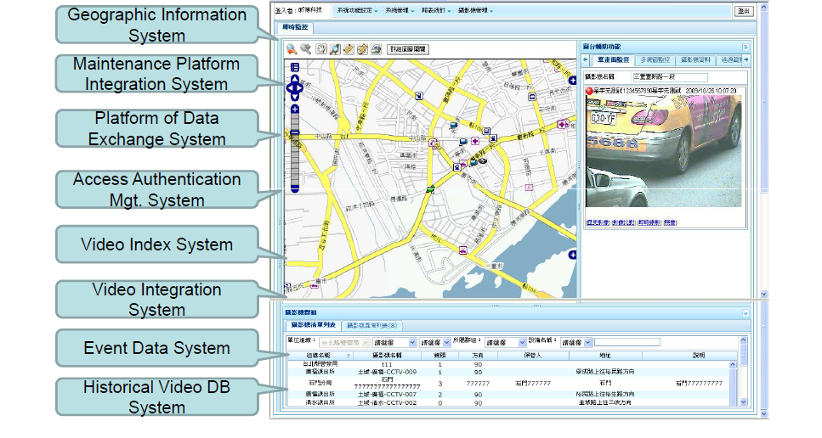
Subsystem 3rd party software integration

Slide 25
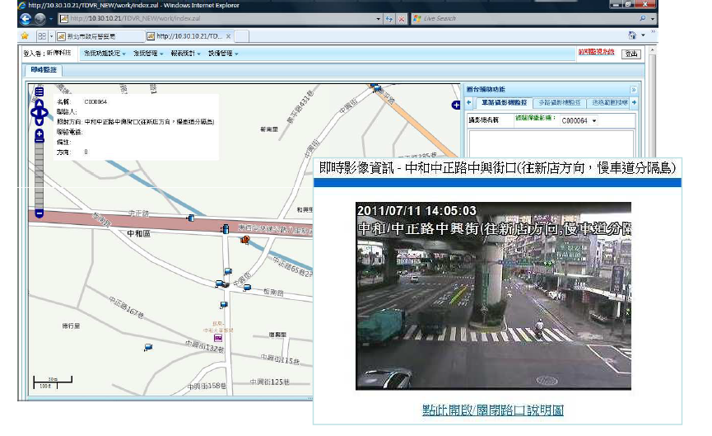
3rd party integration
- GPS integration

Slide 26
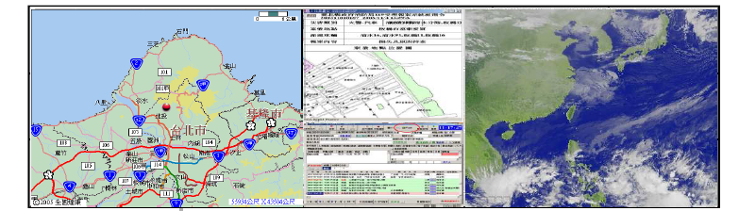
3rd party connection Integration
-AMX automatic control system Integration
Full graphical user interface Through click and drag, can choose the video source, and do all kinds of size, scale, displacement and other changes. According to the situation occurs, the display will automatically zoom images and electronic maps of the region. Integrated control of the case shows, conferences, video, audio, lighting ... And other systems, emergency personnel to shorten the reaction time.

Slide 27
Surveon Solution Advantages
The only in house design camera, NVR and Storage devices provider in surveillance industry
End to End full integration. Performance and stability complete examination
Optimize and enhancement for high definition Management and recording
Design for NVR and Storage not simply outsourcing COTS solution bundle with software
High quality Megapixel HD Cameras and enterprise CMS software
15 years Taiwan company, worldwide customers and products
Full product line Industrial components and 3 year product warranty
Notes:
27

Slide 28
Question and Answer
Notes:
28

